Slide 1
Understanding Financial Statements
Notes:
Welcome and thank you for attending this exciting presentation of Understanding Financial Statements!

Slide 2
Financial Statements
Business Report Card
Your Lodge IS a Business!
Officers’ Duty to be Financially Responsible
Indispensable Tool for Sound Business Decisions
Administrator should provide these at every Meeting
Notes:
Financial Statements provide a report card on your business.
Remember that your Lodge IS a business and as officers you have a duty to be financially responsible in making business decisions
The financial statements are an indispensable tool for making sound business decisions.

Slide 3
Financial Statements
Balance Sheet
Snapshot of Business Worth
Profit & Loss
Income, Expenses & Profit/Loss over a Period of Time
Notes:
There are two types of Financial Statements that we will go over today.
The Balance Sheet provides a snapshot of the net worth of the business at a given point in time.
The Profit & Loss Statement shows us Income, Expenses and whether the business made a profit or loss over a specified period of time.

Slide 4
Financial Statements
Balance Sheet
Assets
Cash
Bank Accounts
Petty Cash
ATM/Credit Card Clearing
Accounts Receivable
Inventory
Fixed Assets
Buildings & Property
Furniture & Equipment
Notes:
So, What appears on the Balance Sheet?
First category is Assets, what is owned by the lodge.
Cash: Bank Accounts, Petty Cash, ATM/Credit Card Clearing
Accounts Receivable: money owed to your lodge
Inventory: Merchandise for resale
Fixed Assets: Buildings & Property, Furniture & Equipment

Slide 5
Financial Statements
Balance Sheet
Liabilities
Accounts Payable
Notes Payable
Mortgage
Payroll & Benefits Liabilities
Tax Liabilities
Sales Tax
Due to Other Fraternal Units
Notes:
Second Major Category is Liabilities
Accounts Payable: Bills that you owe
Notes Payable: Mortgages and Loans
Payroll & Benefits Liabilities: Taxes withheld and owed to government agencies.
Tax Liabilities: Sales Tax, Property Tax
Due to Other Fraternal Units: Endowment Fund, ABCD, Application Fees, Dues paid at the lodge to be forwarded to the lockbox

Slide 6
Financial Statements
Balance Sheet
Net Worth (Equity)
Notes:
Balance Sheet Bottom Line:
Assets minus Liabilities equals Net Worth

Slide 7
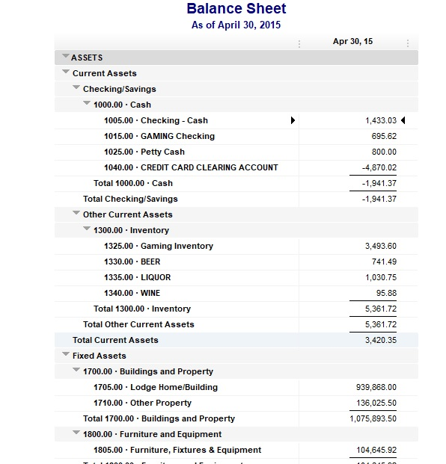
Notes:
Point out potential errors,
ask audience if they can spot any errors.

Slide 8
Notes:
Point out potential errors,
ask audience if they can spot any errors.

Slide 9
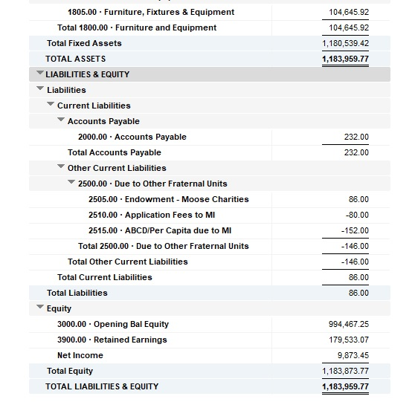
Notes:
Point out potential errors,
ask audience if they can spot any errors.

Slide 11
Financial Statements
Interpreting the Balance Sheet
No Negative Amounts
Stable Liability Accounts
Accounts Payable
Payroll Liabilities
Due to Other Fraternal Units
Endowment Fund
ABCD/Application Fees
Dues to be Forwarded
Compare Current with Prior Fiscal Year End
Notes:
There should be no Negative Amounts on the Balance Sheet, if there are negative amounts, errors are being made in recording transactions.
Liability Accounts should be somewhat stable.
If Accounts Payable appears high, generate and review the A/P Aging Report
Verify that Payroll Tax Liabilities are being remitted to the appropriate taxing authority
Due to Other Fraternal Units, The Endowment liability account should only be used for Endowment funds Collected from members, additional funds donated by the lodge should use the Donation Expense Account. Failure to do this will result in a negative liability account balance.
ABCD/Application Fees, should match up with the amounts billed by Moose International on the monthly statement
If a member pays dues to the lodge, it must be forwarded to the dues lockbox.
The liability accounts should function as money comes in, the same money goes out.
Compare to the previous month or the prior fiscal year end to detect issues.

Slide 12
Financial Statements
Interpreting the Balance Sheet
Common Errors
Fluctuating or Increasing Petty Cash Amount
ATM/Credit Card Clearing
Negative Liabilities
Endowment Fund
ABCD/Application Fee
Notes:
So, what are some errors we have encounter when reviewing Balance Sheets?
Increases and decreased in Petty Cash Balances.
ATM/Credit Card Clearing (Balances of either negative or positive when all transactions have cleared).
Negative balances in Liabilities accounts.
Endowment Fund
ABCD/Application Fee

Slide 13
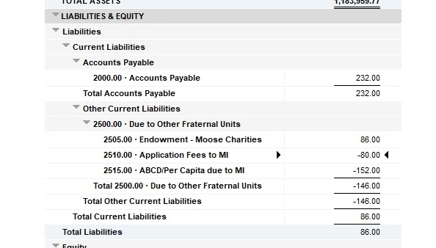
Financial Statements
Notes:
Explain why negatives appear in liability accounts, in this case, the Moose International bill is being entered correctly but the funds received from applications is not.
Funds going out, but not coming in

Slide 14
Financial Statements
Profit & Loss(Income Statement)
Income
Expenses
Profit/Loss
Notes:
What does the Profit &Loss Statement include?
Income minus expenses tells us whether we had a profit or a loss

Slide 15
Financial Statements
Profit & Loss
Income
Dues Income
Social Quarters Sales
Gaming Income
Committee Income
Notes:
Income - Where do we get money?
Dues Income
Social Quarters Sales
Gaming Income
Committee Income
Where else may income be obtain?
Donations Open to the Public Events

Slide 16
Financial Statements
Profit & Loss
Expenses
Cost of Goods Sold(COGS)
Payroll
Supplies
Occupancy
Administrative
Committee
Travel & Rep Expense
Notes:
Expenses
What do we spend money on?
Cost of Goods Sold (Beer, Liquor, Wine, Pop, and Food. Just to name a few).
Payroll
Lodge, Social Quarters, and Kitchen Supplies
Occupancy (Utilities, maintenance, insurance).
Administrative (Office costs)
Committee expenses
Travel and Representatives (Delegates) expenses

Slide 17
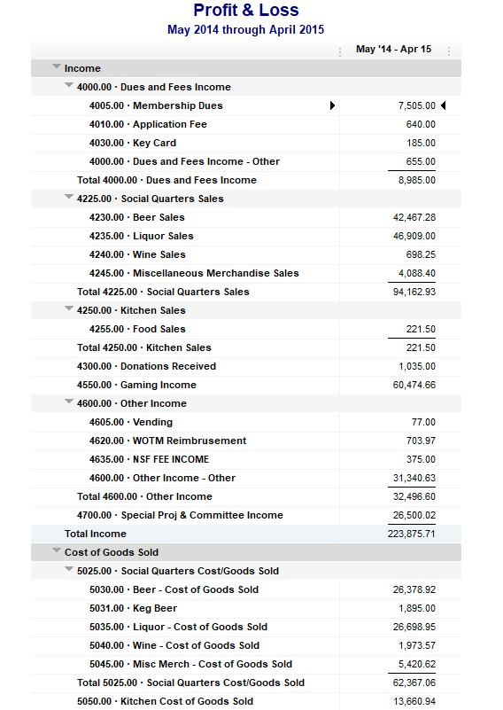
Notes:
Let’s review this first page of this Profit and Loss Statement.
Do you see any items that might be of concern?
Are Sub-Accounts being use?
Where did the money come from?
Where did it go?

Slide 19
Financial Statements
Next Steps
Errors on the Balance Sheet
Correct Processes
Territory Manager/Regional Manager
Financial Review Specialist
Inadequate Profit
Territory Manager SQ Analysis
Financial Review Specialist
Notes:
What steps do we take if we find issues with the financial statements
Balance sheet, ensure that you are using the procedures taught by the training department
Consult with your Territory or Regional Manager,
they will either assist in correcting or may determine that a Financial Review Specialist should make a visit to make corrections and implement proper procedures.
Losing money or not making enough?
Your Territory Manager can conduct a social quarters analysis that will reveal areas where performance can be improved.

Slide 20
Financial Statements
Questions

