Slide 1
Hall Rental Insurance Overview
Why & How?

Slide 2
Is it just another expense?
It could be the difference between your Lodge’s financial survival and remaining a successful part of your community.
Or financial ruin which could affect your Board of Officers as well as the Lodge.

Slide 3
When alcohol is being sold, served, given away, or consumed during such rental.
Hall Rental Insurance is required!

Slide 4
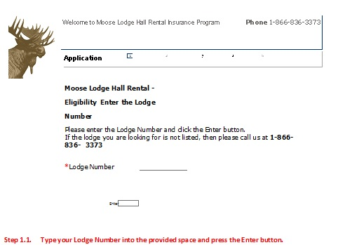
Hall Rental Insurance is available online ONLY! Let us walk through the form:
Step 1.1 Type your Lodge Number into the provided space and press the Enter button.

Slide 5
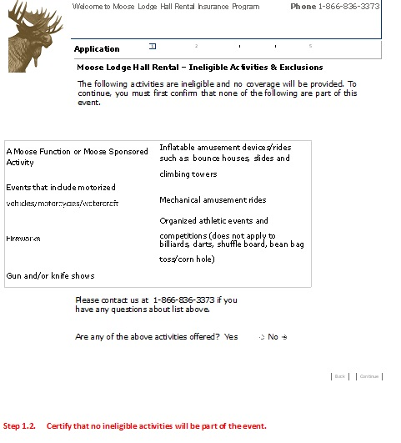
Step 1.2 Certify that no ineligible activities will be part of the event.

Slide 6
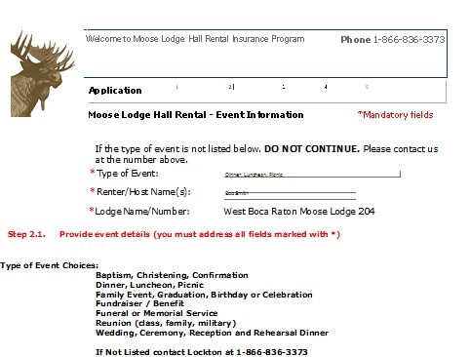
Step 2.1 Provide event details (you must address all fields marked with *)

Slide 7
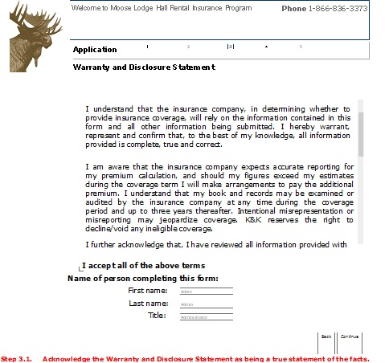
Step 3.1 Acknowledge the Warranty & Disclosure Statement as being a true statement of the facts.

Slide 8
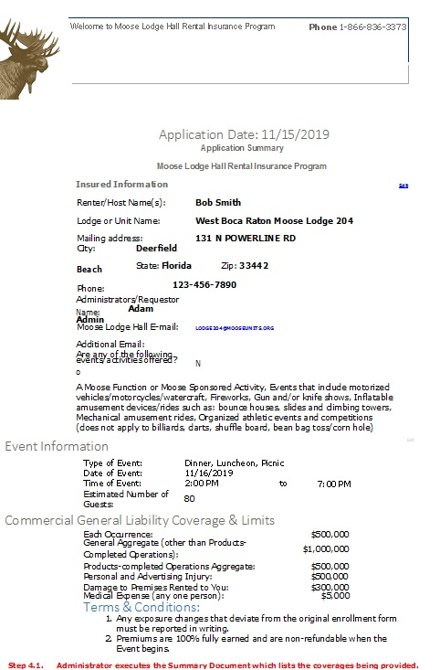
Step 4.1 Administrator executes the Summary Document which lists the coverages being provided.

Slide 9
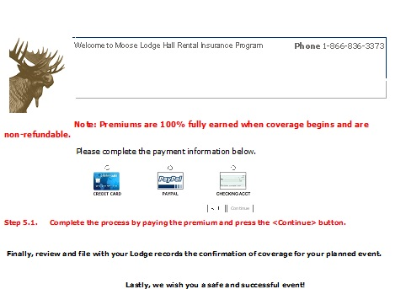
Step 5.1 Complete the process by paying the premium and press the <Continue> button.

Slide 10
When renting to Non-Profit or Municipal Entity
Renting Entity’s Insurance must have Liquor Liability & NOT Host Liquor.
Lodge and Moose International must be named as an Additional Insured on a Primary Basis.
Send the Certificate of Insurance for review to General Governor’s Office or Risk Management for review.

Slide 11
Contact Lockton for multi-day event quote and/or general inquiries. Lockton can be reached at: (866) 836-3373 More Resources Available at: Mooseintl.org Go to Forms & Documents Click on Lodge Operations Legal/Risk Management Tab

