Slide 1
Lodge Elections Workshop 2023

Slide 2
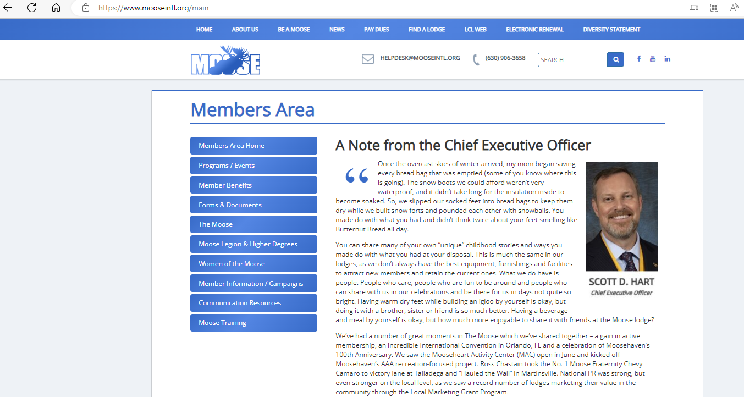
Where do I find the election handbook?

Slide 3
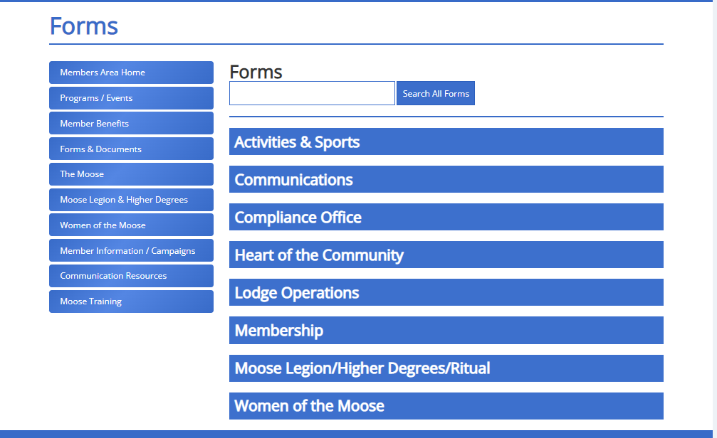

Slide 4
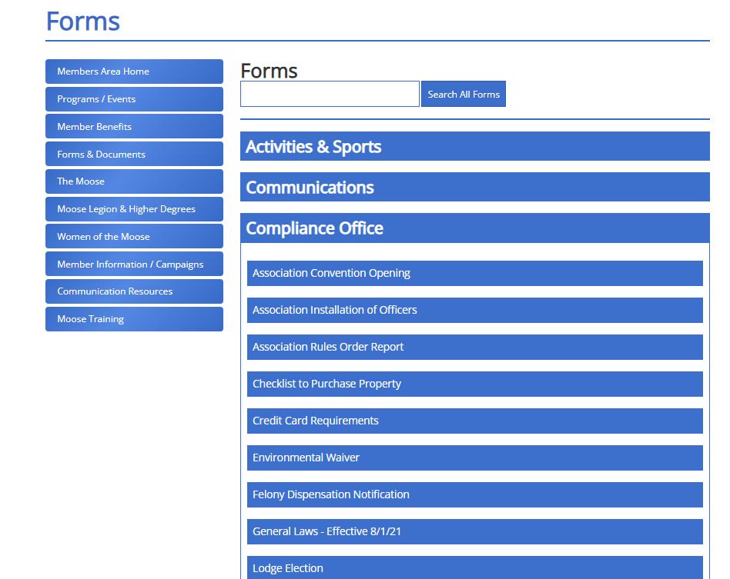

Slide 5
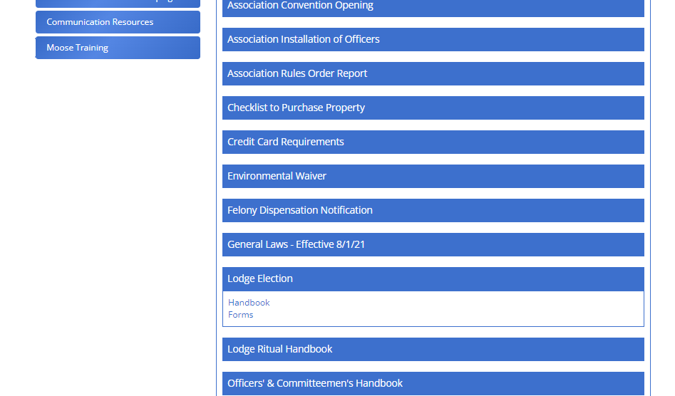

Slide 6
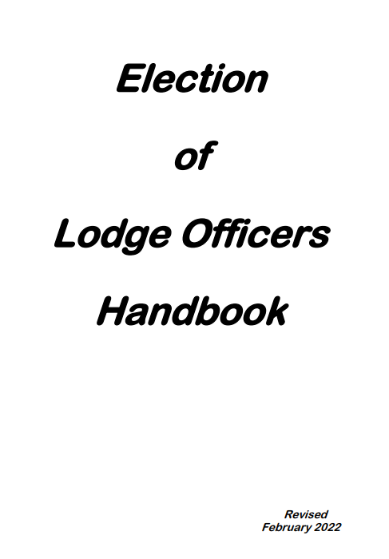

Slide 7
Responsibilities of officers President
Preside over all meetings
Preserve order
Enforce all orders of the order
Appoint committee chairmen, Including “Financial Review “
Oversee the deposit of all lodge funds & is a signer on all lodge checks

Slide 8
Responsibilities of officers Vice President
In the absence of the president, preside over all meetings
Member of the Mooseheart-Moosehaven admissions committee

Slide 9
Responsibilities of officers Chaplin
In the absence of the president& vice president, preside over all meetings
Serve on the “Financial Review” committee
Visit the sick, disabled, & distressed whenever possible, & make a full report at each lodge meeting

Slide 10
Responsibilities of officers Treasurer
Receive & receipt (initial) all deposit slips
A signer of all lodge checks
In the absence of the administrator, will perform all responsibilities & duties

Slide 11
Responsibilities of officers Trustee
Inventory all furniture 7 fixtures annually
Inventory all merchandise for resale monthly
Examine & approve all bills

Slide 12
Responsibilities of officers Jr. Past President
Not an elected position, it is a condition

Slide 13
Qualifications
Must be a member of the lodge they are running for office
President, Vice President, Chaplin – must be member in that lodge for at least 6 months, been a elected officer for at least 1 year

Slide 14
Nominating Committee
8 elected officers
5 Past Presidents by Juniority
5 members of the lodge who are committee chairpersons or Past Presidents
Hold at least 3 meetings
Make there report at the last general membership meeting in March
Primary responsibility is to select at least 1 candidate for each elective office

Slide 15
Any member desiring to run for an elected office shall submit their name to the Nominating Committee

Slide 16
Petitions
Only members turned down by the nomination committee are eligible to run by petition
Petition forms are available from the administrator
Petition signatures required:
10% of the first 500 members & 5% of the excess over 500
Signers must be in good standing & petition must be turned in at least 1 week before the election

Slide 17
Campaigning
VERBAL ONLY!

Slide 18
Meetings
Committee should have been formed at the last general membership meeting in February
3 meetings in March
Nomination committee makes final report at the 2 general membership meeting in March

Slide 19
Election
President appoints election committee (3 members)
Election is held at the 1st general membership meeting in April
Voting may be done by sign of the moose or paper ballot (must be decided at a general membership meeting prior to the election)

Slide 20
Question & Answer

Slide 21
Wish to make a comment about this Workshop or suggest a topic for a future Workshop? Email: Mike Rios, Director of Membership mrios@mooseintl.org Thanks again!

