Slide 1

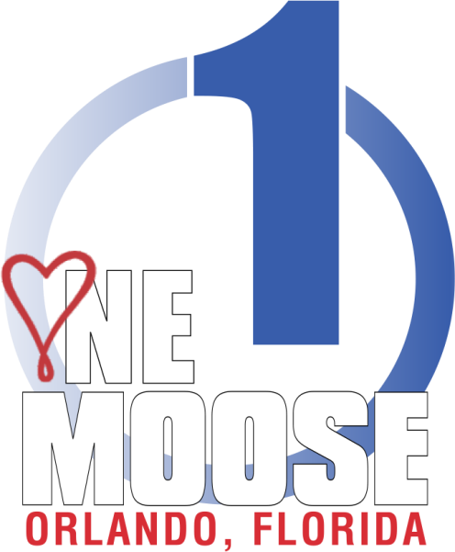
Town hall meeting
November 1-3, 2019
RECAP
Notes:
How many of you have heard of the “One Moose” concept?
How many of you attended the One Moose Town Hall meeting in Orlando this past November?
How many of you have questions and concerns about the proposed future of our fraternity?
Well, it is my duty to help explain the details of the proposed structure so you, the membership, has a greater understanding and increased confidence in what lies ahead.
Suggestion for manageable crowds:
Place a post it or small piece of paper on every seat or give to attendees as they enter the meeting room.
You received a piece of paper as you entered the room. Before we get started I want you to write down the most pressing question(s) you have about One Moose. This will allow you to concentrate on the presentation without worrying about forgetting your question. It is likely your question will be answered throughout the course of this workshop, but if not, there will be time at the end.
Let’s start by talking about the vision of One Moose. (next slide)

Slide 2



The vision of one moose
Vision of One Moose has been around for decades
2017 committee formed for the purpose of uniting our fraternity
Discussions Included:
  Membership and leadership roles
  Men and Women equal membership positions, honors,
  Higher Degrees and dues
Minutes documented timelines, models, pros and cons, dues and
potential losses and gains
All in agreement that changes were necessary
Notes:
The vision of “ONE MOOSE” has been around for several decades, but until recently, did not demand the attention of our membership. That’s correct – our membership – especially newer members and prospective members–revealed a desire for change. Members often question the current Moose structure of men and women not having an equal voice in the operations of the Moose Home.
Therefore, in 2017, the Supreme Council authorized a committee to be formed for the purpose of uniting our fraternity as “One Moose”…men and women working together in leadership positions, making decisions relating to the business and day to day operations of our Moose homes.
The committee met for the first time in September of 2017, and has met regularly since, face to face as well as via video/conference calls.
Discussions included, but were not limited to membership and leadership roles, men and women holding equal membership positions, honors, Higher Degrees, and dues. In our efforts to reshape our organization, the committee reviewed other organizations’ efforts for single membership. The committee was in agreement that in order to fulfill expectations for current membership, as well as for future generations, changes were necessary.

Slide 3

A comprehensive study
3,500 individuals responded to a 2018 survey of current, dropped
and prospective members
Prospective members are specifically looking for equality in
decision-making leadership roles
Met with Supreme Council and Grand Council
to introduce committee goals, share progress
and get input
Notes:
How did the committee know what the membership desired?
A COMPREHENSIVE STUDY
In early 2018, a study was done by an outside source who surveyed current, dropped, and prospective members to determine if they were ready for the magnitude of these changes.
The survey was completed, and the results were in, revealing our members are ready and prospective members are specifically looking for equality in decision-making leadership roles. The committee reaffirmed its purpose and goal to forge ahead with the vision of “One Moose”, with equal opportunity and responsibility for both men and women of our fraternity.
The committee met with the entire Supreme Council and Grand Council together to introduce the committee’s goals, share the progress, and get their input.

Slide 4
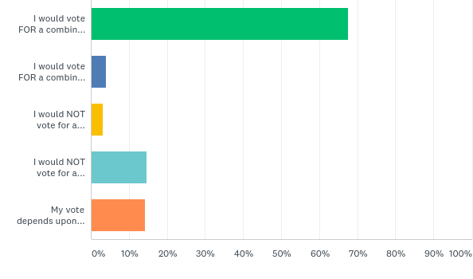
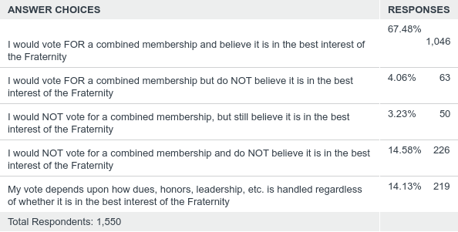
Please check the box that most closely aligns with your feelings regarding the possibility of combining the men and women of the Moose into a single membership category:
Answered: 1,550 Skipped:
Notes:
So what did they find? Of 1550 respondents,
67.5 % of those surveyed responded they would vote FOR a combined membership and believes it is in the best interest of the Fraternity.
14.5 % responded they are NOT in favor of single membership and do NOT believe it is in the best interest of the Fraternity.
14 % said they needed more information to make an informed decision– dues structure, leadership opportunities, honors, etc.
Since the Town Hall meeting, online responses indicate an 83% overall approval rating from members in active status (men & women)
Of 3,377 online responses, 74% of LOOM members are in favor of One Moose. 92% of WOTM are in favor of One Moose. Of 582 delegates who voted on the smoking issue in Las Vegas, 80% voted online in favor of One Moose.
In conclusion, percentages have remained constant since the initial data was compiled - approximately 8 out of 10 members believe our Fraternity needs an update.

Slide 5

2019 Member Survey
No
Yes
Membership would decline
Don’t try to fix something that isn’t broke
Men need safe spaces
It will take away everything in terms of Honors;
Green Cap, Pilgrim, etc.
I am an Old Timer and it’s Tradition
General Laws are not established for this to happen
Diversity breeds new ideas and better leadership
Benefit to the Lodge depends on the individual and not their sex
This would work if women had equal responsibility for the Lodge,
both fraternal and financially
This would appeal to younger generations and help increase membership
Keep our eye on the future but never forget how we got here
Notes:
Here are some of the most reported survey responses…
Reasons for answering “No”
Decline in membership
Don’t fix what isn’t broke
Men need safe spaces
The elimination of honors
Old Timer Traditions
General Laws don’t allow it
Reasons for answering “Yes”
Diversity and better leadership
Benefits to individuals should not be dependent on sex
Equal responsibility, fraternally and financially, for the Lodge
It appeals to younger members & will increase membership
We must look towards the future

Slide 6
The PURPOSE of the FRATERNITY is not changing
Unite in bonds of fraternity benevolence and charity all acceptable individuals of good character…
Educate and improve their members and the families of their members socially, morally and intellectually…
Render particular service to children in need by the operation of one or more vocational, educational institutions of the type and character of the institution now called “Mooseheart”…
Serve aged members and/or their spouses at one or more institutions of the character and type of the place called “Moosehaven”…
Cite: General Laws, Constitution, Purposes
Notes:
Although the Stand As One Committee and leadership of the Fraternity are proposing revisions to the structure of the Moose, let me be very clear - The purpose of the Fraternity is NOT changing!!
The Moose will remain a fraternal organization focused on charitable endeavors.
We will continue to:
Maintain fraternal benevolence and charity
Educate and improve members and their families
Render service to children in need and
Serve aged members and their spouses

Slide 7

Proposed
New Lodge
Management Structure
Notes:
Let’s take a look at the proposed Management Structure of the new Moose Lodge and why the committee is recommending these specific changes.

Slide 8

Membership History and Future Goals
Membership History
Goals Moving Forward
  A New Organization
  Same Mission
  Reorganized Lodge and Organizational Leadership Structure
  A Workable Dues Structure for Long-Term Organizational Sustainability
  Honor and respect our Legacy, work in the present,
  and strive to ensure our future
Notes:
As you may know, Membership in the Order has been declining for decades: On 4-30-1991 we had 1.3 million LOOM members and 2,259 Lodges
By 4-30-2019 we were down to 537,587 LOOM Members and 1,431 Lodges
WOTM membership has not experienced such drastic drops, but membership has decreased.
The Goals Moving Forward are as follows:
To create a New Organization.
The “One Moose” concept will compliment and replace the current LOOM/WOTM structure while providing greater resources for our mission. Let me emphasize the women aren’t joining the men – current Moose members (both men and women) will become part of the new organization.
We will keep the same Mission.
The spirit of the LOOM and WOTM will remain, as will the Mission Statement.
There will be a reorganized lodge and organizational leadership structure. There will be true equality at every level of the organization. All members, regardless of gender, will have a voice in the management of the local lodge. Additionally, Moose management will consist of men and women.
The committee has a commitment to determine a workable dues structure for long-term organizational sustainability.
And the new structure will maintain the Higher Degrees system. Higher Degrees will not be drastically changed – which we will discuss in more detail shortly.
We must “Honor and respect our legacy, work in the present but work to ensure our future.”

Slide 9

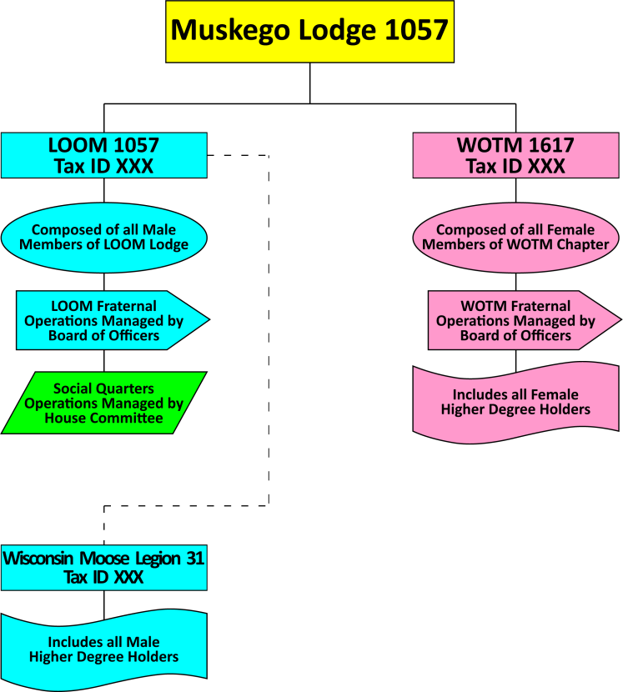
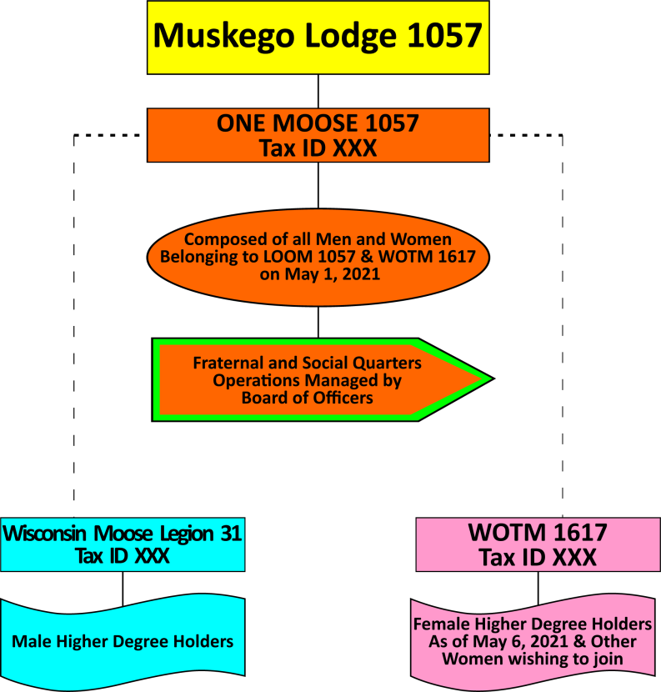
Proposed New Structure for Lodge Leadership
Current
Notes:
The diagram on the left shows the current Lodge structure. The right shows the proposed new structure.
The new Lodge will keep its current Tax ID #, will be comprised of active LOOM & WOTM members (dues paid at time of implementation), and the fraternal and social quarters operations will be managed by a Board of Directors.
The Moose Legion Committee will remain a committee of the Lodge.
Moose Legion Jurisdictions will remain as they are now – comprised of male Moose Legionaires, Fellows and Pilgrims. Moose Legion jurisdictions are comprised of multiple Moose Lodges.
The Chapter will remain an affiliated unit of the new Lodge, comprised of female members, including but not limited to WOTM Higher Degree holders, just as it is now. Female Lodge members may join the Chapter to learn more about our fraternal operations, support programs of the Women of the Moose, or earn higher degrees.
The new unit will be known as the Moose Lodge so we do not need to re-incorporate every unit, to maintain consistency and name recognition within the community, and to reduce expenses of new branding (signage, logos, stationary, etc.)

Slide 10

Proposed New Structure for Lodge Leadership
Notes:
The new Lodge structure will consist of at least 7 members of the Board of Directors to be named Lodge President, Lodge Vice President, Lodge Treasurer, Trustee(s), Lodge Past President, Administrator and Chaplain.
A few items to note:
There will be no limits on gender composition
The House Committee will cease to operate as a management body. The Board of Directors will manage all social quarters operations in an executive session meeting.
Qualifications
Only members of the Moose Legion or Chapter are eligible for Board of Director positions – if he/she is not a member of one of these units, he/she must join within 60 days of taking office.
All Board of Director positions will be elected annually, with the exception of Administrator which will remain a “term of satisfactory service”

Slide 11
Proposed New Structure for Lodge Leadership
Notes:
As you can see here, the proposed committee structure has been revised as well. Some committees may not be part of the new Moose operations, such as Mooseheart/Moosehaven, Moose Charities, and Ritual. These fraternal committees will move into the Higher Degrees units (Moose Legion and Chapter organizations)
This table isn’t meant to represent the committees within the Moose Legion and new Chapter organizations. They will also likely have committees such as membership, community service, etc. to address the importance of those programs on that level.

Slide 12
Proposed One Moose Lodge Meetings
Proposed Moose Lodge Meetings
  Board of Directors will meet twice a month, and each of those meetings will likely involve an executive/closed session to discuss social quarters operations (the former House Committee duties)
  Membership meetings will be held twice per month, with at least one of those meetings with Committee reports
  The monthly Joint LOOM/WOTM meeting will be eliminated
  The bi-monthly House Committee meetings will be eliminated
  (replaced with BOD executive/closed sessions)
Notes:
Proposed new Moose Lodge Meetings:
The Board of Directors will meet twice a month, and each of those meetings will likely involve an executive/closed session to discuss social quarters operations (the former House Committee duties)
Membership meetings will be held twice per month, with at least one of those meetings presenting Committee reports.
The monthly Joint LOOM/WOTM meeting will be eliminated as it will no longer be necessary. Requests and communications from the Chapter may be presented by or directly to the Board of Directors.
The bi-monthly House Committee meetings will be eliminated
(replaced with BOD executive/closed sessions)

Slide 13
Proposed One Moose Lodge Dues Structure
Moose Lodge Dues min. $40
Current Life Members
Implementation of Moose Dues
  Men’s dues example
  Women’s dues example
Notes:
New Moose Lodge dues.
Upon implementation, the Moose Lodge dues for each lodge will equal the LOOM dues. After the new Moose Board of Directors has been installed, each Moose Lodge can set their own dues but the minimum shall be $40.00, which will be the ABCD at the proposed time of One Moose implementation.
Current LOOM and WOTM life members will automatically be given life memberships in the new Moose. WOTM life members will also receive life membership in the Chapter.
The new Moose dues structure will become effective for members upon the first expiration of their current dues after implementation of One Moose. For example, if Joe’s current LOOM dues expire on September 30, 2021, then Joe’s new Moose dues (whether the same or different than the current LOOM dues) will be due on that day. If Mary’s current WOTM dues expire on May 31, 2021, then her Moose dues renewal becomes effective on that date.

Slide 14
WOTM: members will have Lodge membership and Chapter membership upon implementation
Lodge
a
Lodge
b
Lodge
c
Chapters:
A
B
C
up to 3 years free with paid affiliated Lodge membership
Notes:
Current WOTM members will receive 3 years of Chapter dues free of charge with a paid Moose Lodge membership.
Multiple Membership as it pertains to WOTM:
If Mary belongs to 3 chapters at the time of implementation, she will automatically belong to those 3 new Moose Lodges. She will also belong to the 3 affiliated Chapters. If she renews her Moose dues in all 3 Lodges, her affiliated Chapter dues will renew automatically each year for a maximum of 3 years.
If she drops one or more of her Moose Lodge dues, that affiliated Chapter dues will expire unless she chooses to renew them. A minimum of 1 Moose Lodge Dues is required for a female to maintain Chapter membership.

Slide 15
Example: Mary belongs to 3 chapters, one of which is a life membership
1 yr
West Bend
Life
Muskego
1 yr
Mht
Muskego
(life)
West Bend
Mooseheart
Notes:
Example: Mary belongs to Muskego, Mooseheart and West Bend Chapters at the time of implementation. She has a life membership in Muskego Chapter. At implementation, Mary will have a life membership in Muskego Lodge, a life membership in Muskego Chapter, a one year membership at Mooseheart Lodge, a one year membership at Mooseheart Chapter, a one year membership at West Bend Lodge and a one year membership at West Bend Chapter.
Note: the committee is proposing 1 membership card per member rather than a card for each unit.

Slide 16

WOTM: Lodge membership and Chapter membership upon implementation
1 yr
W Bend
Life
Muskego
1 yr
Mht
Option to pay
Option to pay
Muskego
(Life)
West Bend
Mooseheart
Notes:
If Mary renews her dues the following year for Mooseheart but not West bend, she will have a life membership in Muskego Lodge, a life membership in Muskego Chapter, a one year membership at Mooseheart Lodge, a one year membership at Mooseheart Chapter free of charge and will have the option of renewing (paying) her dues at West Bend Chapter.
Again, she only needs 1 Moose Lodge Membership to maintain her Chapter memberships.
(CLICK) She could choose to drop the Mooseheart and West Bend Lodge dues, but pay Mooseheart Chapter and West Bend Chapter dues.

Slide 17

Women of the Moose
Chapter of Tomorrow
Notes:
Women of the Moose Chapters – what should be expected?

Slide 18

STRUCTURE
Members desire segregated gatherings
Maintaining honors, charitable focus, lower dues and influence
Chapter will be an affiliated unit of the Moose home/Lodge
Operate similarly but with installed, volunteer positions and meetings reduced
Chapters will maintain their current assets
Chapters will have their own leadership
Chapter unit will serve as a vehicle for WOTM Higher Degrees
Notes:
What will the Chapter of Tomorrow look like? How will it be structured? How will Chapters operate and why will we have gender specific units if we are joining together as One? Based on our extensive research, I quote, “members expect that segregated gatherings would be held in a context where all member benefits and privileges are completely equal.” In other words, current members have a desire to continue to gather as groups of men or women but they don’t feel their rights or privileges in the Moose home should be determined by their gender. The research supported the opinion of the Stand As One committee that women enjoy socializing with other women just as men often enjoy getting together without their female counterparts.
Some of the key concerns from our members for maintaining a WOTM unit are: “existing, lifelong and hard-earned honors for women, the charitable focus of the Women of the Moose, lower dues for Chapter members, and the current influence held by the Women of the Moose.”
In order to achieve these goals, the Women of the Moose Chapter will be an affiliated unit of the new Moose Lodge and Moose International, just as it is now. Chapters will continue to operate similarly to the way they operate now but installed, volunteer positions and meeting requirements will be reduced.
Chapters will maintain their current assets. Chapters will NOT relinquish their funds to the Lodge or Moose International as a result of the One Moose initiative. They will maintain their General Fund, Savings and Investment accounts.
Chapters will have their own leadership (which we discuss in a moment) and
Chapters will serve as a vehicle for WOTM Higher Degrees.

Slide 19

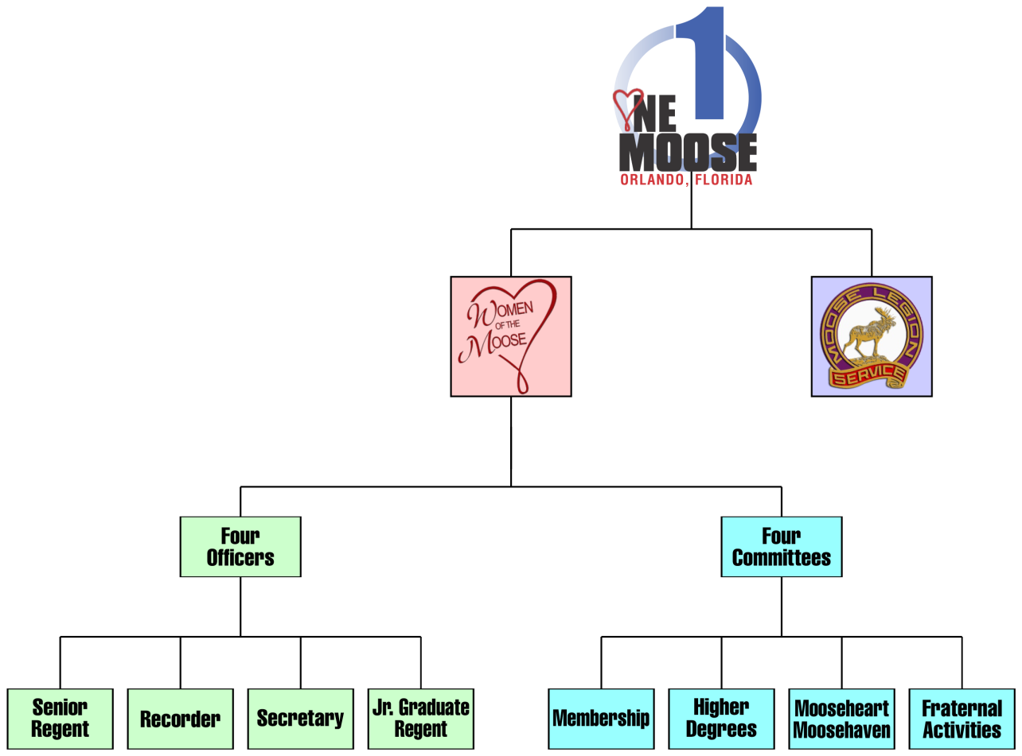
Tentative Proposed Structure
Notes:
As you can see here, the tentative proposed structure has the new Moose Lodge at the top of the pyramid. We, all members, will belong to this unit. Each Moose Lodge will have a Chapter unit and a Moose Legion jurisdictional unit. The proposed chapter structure consists of 4 Officers: Senior Regent, Recorder, Secretary and Junior Graduate Regent. Officer titles may change as additional options are considered. For example, maybe the Recorder becomes the Treasurer.
The committee is recommending having four Installed Chairmen: Membership, Higher Degrees, Mooseheart/Moosehaven, and Fraternal Activities. Just as they do now, Chairmen will commit to conducting fundraising activities as well as member events to preserve our charitable donations to support Mooseheart, Moosehaven and our communities. Chapters provide millions of dollars annually to our programs. We cannot and will not jeopardize the current or future security of our residents under the new structure. Leadership recognizes donations are vital to maintaining the quality of life we have promised our children and senior members.
Specific responsibilities of each committee will be determined at a later date but as you can assess from the proposed titles, we recognize the importance of our current fraternal obligations.
Membership is at the cornerstone of our existence; this also includes member retention.
The Higher Degree chairmen will help promote chapter and personal success, explain traditions and recognize those members who have been elevated within our program.
Mooseheart/Moosehaven; self-explanatory.
Fraternal Activities will also incorporate Community Service opportunities, while promoting fun and fellowship amongst our members.

Slide 20
TERMS OF Operation
The JGR will absorb the duties of the Junior Regent
The JGR will be an office of condition, as it is now.
The JGR will only vote to break a tie during a Board meeting
A quorum will consist of a minimum of 5 members, including 1 officer
A quorum for the Board of Officers will be a minimum of 2 officers
Higher Degree members might be eligible to serve in any elected office
A minimum of 1 Chapter meeting shall be conducted monthly
A minimum of 1 Chapter Board of Officers’ meeting shall be conducted
monthly; could be same day/night as the Chapter meeting
Notes:
Let’s take a closer look at our proposed operational structure. While specific terms of office will be determined at a later date by the committee and Grand Council; some or all offices could potentially be held for consecutive terms.
Will there be forms to fill out? Probably. Will there be donations to be remitted? Absolutely! Our chapters and members will be asked to continue to support Moose Charities to ensure the future security of our beloved residents.
The Grand Council has tentatively approved the following:
The Junior Graduate Regent will absorb the duties of the Junior Regent; she will lead the chapter in the pledge to our countries, devotional exercises, and visit with sick or distressed members. She would preside in the absence of the Senior Regent.
The Junior Graduate Regent will be an office of condition, as it is now.
During a Board meeting, the Junior Graduate Regent would only vote to break a tie.
A quorum will consist of a minimum of 5 members, including 1 officer
A quorum for the Board of Officers will be a minimum of 2 officers
Higher Degree members might be eligible to serve in any elected office; additional discussion by the Grand Council will transpire on this topic.
A minimum of 1 Chapter meeting shall be conducted monthly for the purpose of approving applications, conducting business, paying bills, etc.
A minimum of 1 Chapter Board of Officers’ meeting shall be conducted monthly which may be conducted on the same day/night as Chapter meeting.

Slide 21
DUES
Proposed minimum annual dues for Chapter membership is $15.00
Dues in the Chapter will be waived for 3 years for current members
After the 3 years ALL Chapter members will pay Chapter dues, with the exception of Life members
A minimum per capita rate will be determined
New/reinstated/reenrolled members will pay a minimum of $15.00
No application fee at the Chapter level
Higher Degree status will remain active so long as Chapter membership is in good standing
Notes:
The proposed minimum annual dues for membership in the new Chapter is $15.00, however for current WOTM members in active status at the time of implementation, dues in the Chapter will be waived for 3 years based on the member’s expiration date. For example, if a member has paid her dues ahead, she will NOT lose those years of payment and her dues will be waived for an additional 3 years.
After the 3 years, ALL members desiring to maintain their Women of the Moose affiliation will pay dues to the Chapter. Payment of dues will also maintain Higher Degree status. As a reminder, you can use your Moose Member Rewards Points to pay your dues.
Current life memberships will be honored – life members will not pay additional dues to the new Moose Lodge or to the Chapter.
A minimum per capita rate will be determined to help fund Mooseheart/ Moosehaven operations as well as the local Chapter.
New, reinstated or reenrolled members will pay a minimum of $15.00 annually at the time of application to the new Chapter.
There will NOT be an application fee at the new Chapter level.
If the member has been invested with any Higher Degree, her degree status will remain active so long as her Chapter membership is in good standing (active status).
As you may have noticed, this proposed structure mimics the Moose Legion.

Slide 22
STAND ALONE CHAPTERS
Will need to be chartered as a new Moose Lodge
The current WOTM Chapter will continue to exist
Chapter members also become members of the new Moose Lodge
Once funds and opportunities are available, the members would have the opportunity to lease or purchase property, manage the social quarters and oversee the overall operation of the Moose home.
Notes:
You may be wondering, what happens to Stand Alone Chapters?
A unit of members will need to be chartered as a new Moose Lodge, but the current Chapter will continue to exist. Essentially all the current Chapter members also become members of the new Moose Lodge and will be instrumental in managing, growing and improving the program. Membership will grow consisting of both men and women. The new Board of Directors will be nominated and elected from the pool of eligible members. Once funds and opportunities are available, the members would have the opportunity to lease or purchase property, manage the social quarters and oversee the overall operation of the Moose home.
As for lodges without affiliated Chapters, female members will have the availability of transferring their Allheart (General Assembly) membership to the local unit.
Essentially, Allheart members will receive membership in General Assembly (the new Lodge) at the time of implementation and will receive 3 years dues in Allheart (the new Chapter) with paid membership at the Lodge level. General Assembly and Allheart members can transfer to a local unit free of charge.
The committee still needs to determine Board of Directors eligibility at the local Lodge if a female is a member of Allheart because the Lodge does not have an affiliated chapter. It may need to be authorized via dispensation on a case-by-case basis.

Slide 23
Recognition & AWARDS
Imperative to have recognition programs
Award of Achievement?
Some attainable incentive for Chapters to strive for
Will promote teamwork within the chapter, help maintain and increase membership in the Order, sustain charitable giving and most importantly,
“Bring women together in a closer fraternal relationship to assist in charitable activities of the Moose fraternity, with special attention to Mooseheart and Moosehaven.”
Notes:
It is imperative that Women of the Moose Chapters continue to have recognition programs. The committee has discussed the need for sponsor recognition at all levels of the fraternity, the importance of volunteer recognition programs, and the Grand Chancellor and Grand Council have brainstormed the future of the Award of Achievement.
Will the requirements be exactly the same as they are now? Probably not, but there will be some type of attainable incentive for Chapters to strive for. This “award” may serve as the pre-requisite for earning Higher Degrees. Like it does now, the Award of Achievement, or whatever it is called, will promote teamwork within the chapter, help maintain and increase membership in the Order, sustain charitable giving and most importantly, “Bring women together in a closer fraternal relationship to assist in charitable activities of the Moose fraternity, with special attention to Mooseheart and Moosehaven.”

Slide 24


FUTURE OF
HIGHER DEGREES
Notes:
Let’s discuss the future of Higher degrees.

Slide 25

Our Goal is to Preserve Tradition
but Modernize
Some things may “morph” further in the future
Meet the needs and desires of our members and our overall mission
It is our intention to continue to recognize leadership for their
accomplishments and contributions to the organization
It is our way as an organization to say “THANK YOU”
Notes:
The goal is to preserve traditions but modernize –
recognizing some things may “morph” further in the future; something that appeals to the membership, recognizes their accomplishments, and elevates the member in our Fraternity.
Historically we have seen revisions to meet the needs and desires of our members and our overall mission.
Higher Degrees are our way as an organization to say “THANK YOU” for your service and dedication.

Slide 26

What are the Planned Changes?
Current structure will essentially remain intact
Essentially LOOM Higher Degree qualifying attributes will remain as they are now
WOTM degrees will remain similar to as they are now
What might change? Terminology and specific requirements
    Past Governor might be Past President
    College of Regents might become College of Presidents
    Award of Achievement requirements may be altered
Notes:
What are the planned changes to Higher Degrees? Not much.
Attributes for qualifying for WOTM or Moose Legion degrees will remain similar to what we currently know. As a reminder, Moose Legions will remain jurisdictional, chapters will remain affiliated with the Lodge.
What might change? Terminology and specific requirements. For example a Past Governor might be Past President or College of Regents might become College of Presidents.
New requirements for what we now know as the Award of Achievement could directly affect how honors/degrees are earned.
In comparing LOOM and WOTM degrees, some similarities exist such as sponsorship requirements but you cannot directly equate one degree to another.

Slide 27

The Future of Degrees and Honors
Award of Achievement
Once conferred with any higher degree – the degree stays with the member as long as both his/her lodge and Moose Legion or Chapter dues remain in active status
  Honors and Degrees can only be earned by a member of the Chapter or Moose Legion
Notes:
Presently the Award of Achievement must be earned by the whole Chapter in order for Co-workers to earn degrees. The Grand Chancellor and the Grand Council will need to evaluate requirements once the New Chapter structure is finalized, determining how the Award may/will be altered.
Higher degrees are valid provided the member has active status in both a Lodge unit and a Chapter or Moose Legion unit.
Honors and degrees can only be earned by members of the Moose Legion or Chapter.

Slide 28

Fellowship Degree of Honor
All lodges are sent recommendation forms
Minimum requirements for consideration (all by Sept 30th):
  Five years continuous lodge membership
  One year continuous ML membership
  Minimum 5 members sponsored into the Order
    One of which transmitted since prior May 1st
  Minimum 1 member sponsored into the ML in lifetime
  Have a record that demonstrates extraordinary service to
  the fraternity which clearly shows his worthiness of elevation
Recommendations are made by Lodge Fellowship Committees
Reviewed by Moose International and passed to Pilgrim Council for consideration
Degree Conferral is required
Up to four invites for conferral to approved candidates
Notes:
While the Moose Legion Council will monitor and review the requirements after implementation, it is anticipated the Fellowship Degree requirements will remain as we currently know them.
All Lodges are sent recommendation forms; the Lodge Fellowship Committee will remit the name(s) of qualified Moose Legionaires for elevation to the Fellowship Degree of Honor.
Minimum membership and sponsor requirements will remain; qualified members of the Moose Legion who demonstrate exemplary service are eligible for nomination.

Slide 29
Pilgrim Degree of Merit
Recommendations are made by any Pilgrim in Good Standing
Good Standing male member of lodge for at least ten years
Five continuous years as a Fellow
25 Club member
Past Governor of Order and
Elected or appointed as officer in either:
  Moose Legion -OR- Association
  OR – Served as Association Chairman a minimum of 5 years
  OR – Appointed to a Supreme Lodge Board or Committee w/in past 5 years
  OR – Successfully Gathered a charter for a new lodge
  OR – Serve as Administrator at least 7 years
  OR – has extraordinary service to the lodge exceeding 20 years
  If approved by Pilgrim Consistory member will be invited &
  must attend a conferral – held at the Mooseheart campus
Notes:
The same is true for the Pilgrim Degree of Merit; changes are not being recommended at this time.
All Pilgrims are sent recommendation forms. Minimum membership, sponsor and leadership requirements will remain; qualified Fellows who have extraordinary service to the fraternity are eligible for nomination.

Slide 30
Chapter Honors and Degrees
  Purpose: Recognize the accomplishments of leaders
Determine specific requirements to be met during the term of office for earning degrees :
  Consistency of Participation
  Enrollment of Members
  Attending training sessions
Notes:
As with all of our honors and degrees, Chapter members will still have specific requirements to be met during the term of office such as…..
Consistency of Participation
Sponsoring of Members
Attending training sessions
And so on
However, some revisions will be necessary…(next slide)

Slide 31
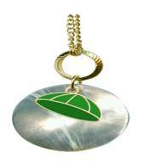
Is the terminology dated?
Green Cap vs. Necklace?
Academy of Friendship:
  Sponsor 5? Sponsor 2? Serve new Lodge or only at Chapter level? All TBD
  Possible Future: “Star Degree”? Title change; Financial Director/Treasurer?
  Possible Revisions: “College Degree”? Change the title to President, Chief Presiding Officer, Executive Officer?
  Criteria for earning the degrees may change but degrees are still earned for exceptional leadership
Notes:
GREEN CAP, is this terminology dated? Does it need to be more modern or updated? College freshmen no longer wear “beanies” so maybe we need to consider revising references from a cap to a necklace.
As a reminder, in the proposed future of the degrees, only Chapter members (females) would be awarded these degrees. Maybe the requirements are revised as follows:
Academy of Friendship: sponsor 5 members into the Moose or maybe 2 into the Chapter in the same fiscal year. Hold an installed position - at what level? Specific requirements are yet to be determined Grand Council, which meets in February 2020.
What will become of the Star Recorder degree? Calling it the “Star Degree” will maintain traditions but allow for the title of Recorder to change and be more recognizable in a financial world. Maybe she will be the Treasurer, the Financial Director, Chief Financial Officer or another name. The committee anticipates this degree will still be awarded for meeting Financial Reporting requirements, sponsoring members and attending training during her term of office.
Possible revisions to the College of Regents Degree could also include a title change. “The College Degree” maintains tradition but allows for changes to the title of Regent, which may be an outdated term. In order to modernize, maybe the Senior Regent becomes the President or Chief Presiding Officer or Executive Officer.
Specific criteria for earning the degrees may change but the degrees will still be earned for exceptional leadership.

Slide 32

The College of Regents Regalia
  Does it appeal to prospective members in today’s society?
  The Cap and Gown, Tassels and Stoles are symbolic of our achievements of “graduating” to an elevated level within our Fraternity
  We must consider all of these traditions as we look
  to modernize our degrees
Notes:
Will regalia Change? Maybe, maybe not.
While the committee recognizes the tradition and honor of the cap and gown…..does it appeal to perspective members in today’s society?
On the flip side……the Cap and Gown is symbolic of achievements of “graduating” to an elevated level within our Fraternity.
The committee is carefully considering all of these traditions in an attempt to modernize our degrees.

Slide 33
Conferrals
  Don’t anticipate major changes upon implementation
  Conferrals have long standing traditions
  Honors, Degrees, Regalia and Conferrals may change in the future
  Members have indicated interest in morphing the degrees into a new program honoring
  both men and women equally
Notes:
Will conferrals change?
At present, the committee doesn’t anticipate any major changes.
Our current conferrals have long standing traditions that will continue to be recognized.
As we journey down this new road, honors, degrees, regalia and conferrals may need to be revised. Members have already indicated an interest in morphing the degrees into a new honors program, honoring both men and women equally. The committee will consider and debate suggestions from the general membership and make proposals accordingly.

Slide 34

ONE MOOSE GENERAL LAWS REVISIONS
Notes:
Now let’s talk about some of the prospective General Laws changes.

Slide 35
MOOSE GOVERNANCE continue to consist of three branches (however the names of the branches will change)
1) LEGISLATIVE.
comprised of the Supreme Lodge, to be retitled the Moose, constituted by all of the member Moose Lodges
2) EXECUTIVE.
comprised of the Director General and the Supreme Council, to be re-titled the Chief Executive Officer and the Moose International, Inc. Board of Directors
3) JUDICIAL.
comprised of the General Governor, to be re-titled the Chief Compliance Officer, and the Supreme Forum
Cite: General Laws, Constitution, Article VIII
Notes:
Moose governance will continue to consist of three branches, however the names of the branches may change.
The LEGISLATIVE branch, comprised of the Supreme Lodge, to be retitled the Moose, is constituted by all of the Moose Lodges
The EXECUTIVE branch comprised of the Director General and the Supreme Council, proposed to be re-titled Chief Executive Officer and the Moose International, Inc. Board of Directors
The JUDICIAL branch comprised of the General Governor, to be re-titled the Chief Compliance Officer, and the Supreme Forum.

Slide 36
Moose International will continue to act as HQ for the system of Lodges
Moose International shall mean the corporation of that name, organized and existing pursuant to the Laws of the State of Indiana
The principal business of the corporation is to act as the headquarters for the system known in the aggregate as the Moose, in matters of common interest to all lodges and chapters
so there may be uniformity of operation in all matters pertaining to the lodge system
Cite: General Laws, Chapter 2, Sec 2.1
Notes:
Moose International will remain the headquarters for the Lodge system
Moose International shall mean the corporation of that name, organized and existing pursuant to the Laws of the State of Indiana (same as it is now)
The principal business of the corporation is to act as the headquarters for the system known in the aggregate as the Moose (currently: Supreme Lodge), in matters of common interest to all lodges and chapters
so there may be uniformity of operation in all matters pertaining to the lodge system, as it is now.

Slide 37
Rules and Regulations
The Constitution, the General Laws, and the rituals shall be the official rules and regulations governing Moose International, Inc. and the Moose.
The rules enacted by the Moose at International Convention for the operation of the member lodges and for the management and operation of all other units of the fraternity shall be binding/compulsory.
Cite: General Laws, Constitution, Article I
Notes:
Rules and Regulations
The Constitution, the General Laws, and the rituals shall be the official rules and regulations governing Moose International, Inc. and the Moose.
The rules enacted by the Moose at International Convention for the operation of the member lodges and for the management and operation of all other units of the fraternity shall be binding/compulsory. (same as it is now)

Slide 38
THE PRIVATE POLICY WILL CONTINUE TO ALLOW ALL MEMBERS TO ENJOY THE BENEFITS OF THE LODGE’S SOCIAL QUARTERS
THE PRIVATE POLICY
(For the protection of our tax free status and
Constitutional Right of Privacy)
"YOU ARE EITHER A MEMBER OR A GUEST!“
All active members of the Order Moose shall be admitted to the social quarters of any lodge of the Loyal Order of Moose Moose unless his or her privileges have been suspended in accordance with the General Laws of the Order Moose.
2. Only the following persons may be admitted as a "qualified guest' into the social quarters or home of any lodge of the Order Moose:
a: An active lodge or chapter member’s spouse.
b: An active lodge or chapter member’s immediate family.
Cite: General Laws, page 143
Notes:
The Private Policy will continue to govern the Social Quarters.
Here are some examples of how terminology in Private Policy may change.
Most references to the “Order” will be replaced by “Moose”.
Remove “Chapter”; all members will be Lodge members.

Slide 39
Membership:
Lodge membership is gender neutral
Chapter 28 - Membership
Sec. 28.1 - Qualifications of Membership - Members of the Order shall be a member of a lodge of the Loyal Order of Moose or a member of a chapter of the Women of the Moose.
To qualify for membership in a lodge, an applicant must:
Be a male person.
Be twenty one (21) years of age or older.
Be of good moral character and capable of understanding the obligation of membership.
Profess a belief in a Supreme Being.
…
Notes:
Changes to Membership requirements:
You must be a person (rather than male or female)

Slide 40
Lodge
Officers- Elected
Sec. 33.5 - Eligibility of Officers - Only active members in the lodge, may be considered for any elected office. Eligibility requirements for lodge offices are as follows:
  Governor Lodge President- Been an active member of the lodge for at least six (6) months immediately preceding the date of election and completed at least one (1) year in another elected office (not a combination of offices) of the lodge in which he they seek office.
  Junior Governor Lodge Vice President - Been an active member of the lodge for at least six (6) months immediately preceding the date of election.
  Prelate - Been an active member of the lodge for at least six (6) months immediately preceding the date of election. NOTE: position will be re-titled to Chaplain
  Treasurer - Must be an active member of the lodge.
  Trustee - Must be an active member of the lodge.
Notes:
Officer Title Changes are reflected here:
Governor to Lodge President
Jr Governor to Lodge Vice President
Prelate to Chaplain
The Lodge President must have been an active member of the Lodge for at least six months and must have completed at least one year in another elected officer before being eligible for this office. These stipulations help ensure a better understanding of Lodge operations.
The Lodge Vice Presents must have been an active member of the Lodge for at least six moths prior to being elected.

Slide 41
Lodge
Officers- Appointed and Elected
Chapter 36 – Administrator
Sec. 36.1 - Appointment and Election - The Administrator shall be nominated by the Board of Officers and elected by a majority vote of the membership at a regular lodge meeting.
Administrator will perform the responsibilities of the Corporate Secretary
Notes:
NO CHANGES (previously proposed re-title to General Manager was rejected by the Supreme Council)
Administrator will remain a “term of satisfactory service” and he or she will serve as the Corporate Secretary.

Slide 42
Lodge
Officers- Appointed and Elected
Chapter 34 - Junior Past Governor Lodge President
Sec. 34.1 - Serves on the Board of Officers - The retiring Governor President shall serve as the Junior Past Lodge Governor President, provided the term of Governor President for which he was they were elected or appointed commenced prior to November 1 of the preceding year and he they completed the term. The Junior Past Governor Lodge President shall be a member of the Board of Officers.
Chapter 39 – Prelate Chaplain
Sec. 39.1 - General Duties - (A) For Lodges using Three Trustees: He shall be a member of the House Committee. In the absence of the Governor President and Junior Governor Vice President, he they preside over the deliberations of the lodge or the House Committee and performs all other duties required of him by the General Laws of the Order Moose. He They also serve as a member of the Financial Review Committee, but not as its chairman.
Notes:
Additional title and pronoun changes.

Slide 43
Social Quarters will be bound by the Rules of the Moose
Chapter 47 - Establishment of Social Quarters
Sec. 47.1 - Adoption of Resolution by Lodge - A lodge may establish and maintain a social quarters or engage in social activities in the lodge home, when the same is established and maintained in accordance with the General Laws and rules and regulations adopted by the Supreme Council Moose International, Inc. Board of Directors. The lodge shall agree, by duly adopted resolution, to be bound by all General Laws, rules and regulations and lawful orders issued by the General Governor Chief Compliance Officer in reference to the social quarters or home.
Notes:
More title updates

Slide 44
Social Quarters will be governed by the Lodge’s Board of Directors.
Chapter 48 - House Committee
Sec. 48.1 - Membership - The government, regulation and control of all social quarters or homes operated or maintained by a lodge shall be vested in a House Committee consisting of the elected Board of Officers and the Jr. Past Governor. The House Committee shall hold at least two (2) meetings each month. Five (5) officers of the House Committee shall constitute a quorum for any meeting of the House Committee.
The House Committee will be eliminated
Notes:
Elimination of the House Committee
As mentioned earlier, the Board of Directors will meet in an Executive Session as necessary to discuss items such as decorum & disciplinary issues and personnel.

Slide 45
State and Provincial Associations
STATE AND PROVINCIAL ASSOCIATIONS
Chapter 51 - Organization
Sec. 51.1 - Creation - By consent of the Supreme Council Moose International, Inc. Board of Directors, the lodges of any state, territory or province shall organize and maintain a state, territorial, or provincial association composed of lodges of that state, territory or province. With consent of the General Governor and Grand Chancellor, an association organized and maintained pursuant to this section may also include chapters. When advisable, an association shall be divided into districts or regions. Members of a district or region shall organize or maintain an association composed of lodges (and chapters if so included) of the district or region.
Notes:
The Supreme Council will be known as the Moose International Board of Directors.
Associations will include all lodges, consisting of male and female members. This will be an easy transition for those Associations already functioning in a Joint capacity.

Slide 46

PROPOSED TIMELINE
AND KEY DATES
Notes:
So, how soon will these changes be presented to the delegates for a vote and when would the new General Laws take effect if they pass?

Slide 47

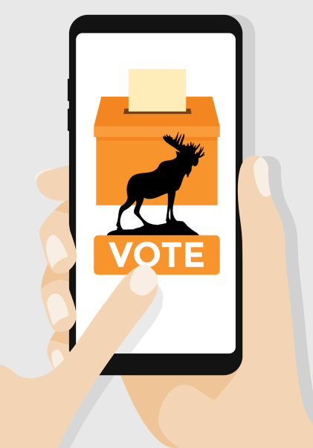
implementation
Conducted a “non-binding” straw poll vote to gauge support for the proposed structure
Prepare a plan to discuss and promote at the 2020 Mid-Year Conferences
Plan to have a General Law Amendment presentation and vote in May 2020 at the Milwaukee Convention
If approved Associations would need to
vote to change their bylaws
Implementation of “One Moose”
would take place May 01, 2021
Notes:
IMPLEMENTATION
Moose International recently conducted a “non-binding” online vote of the membership to gauge support for the proposed structure, and prepare a report for the Supreme Council. Those decisions are being reported here at the 2020 Mid-Year Conferences.
The committee recognizes the timeline sounds aggressive, but plans to have the proposed program finalized for presentation in May of 2020 to delegates at the Milwaukee International Convention. Membership approval would change the General Laws to create the new Moose. If approved in Milwaukee, then Associations would need to revise the Association Bylaws accordingly at the 2020 Annual Conventions.
Although there is still much work ahead to finalize details, the plan for implementation of “One Moose” would then take place on May 01, 2021! Moose International will send communications, devise marketing strategies and revise training to realize this new Moose vision.

Slide 48
Transitioning from Current LOOM to One Moose Lodge
Moose Lodge Identification
Implementation of New Leadership Structure
  May 1, 2020 – No changes to current structure
  May 1, 2021 – Women are members of Lodge
  May 1, 2022 – Women can be elected to BOD
Women will not be eligible to run for office until post May 1, 2021
Women will be eligible to fill vacant positions post May 1, 2021
Notes:
Assuming an affirmative vote for One Moose at the 2020 Milwaukee Convention and a target implementation date of May 1, 2021, here is an outline of transition at the Lodge level:
Lodges and chapters function as current for the 2020-2021 campaign year (since officers will have already been elected).
Summer of 2020 - Communication of changes to membership; there will be promotions, marketing and communications from Moose International to current and former members.
February 2021 – begin nomination process for new Moose Board of Directors (BOD) positions
March/April 2021 – election of the Moose Board of Directors positions. All current LOOM members in good standing are eligible to vote. (current General Laws still govern until May 1, 2021 – non members [women] aren’t eligible to run or hold office until they are members of the Lodge and meet the minimum eligibility requirements of the office)
April 2021 – pre-implementation Audit of LOOM and WOTM units
May 1, 2021 – implementation of the new Moose structure. All current LOOM Lodge numbers will transition to the new Moose. For example: Muskego Lodge #1057 will transition to Muskego Moose Lodge #1057. Women become members of the new Moose. Women may attend Lodge meetings and vote accordingly. Women may be appointed/elected to vacant positions.

Slide 49
Transitioning from Stand Alone to One Moose Lodge
  May 1, 2021 – Lodge is established and Chapter members become members of the new Lodge. Prospective members (men and women) may make application to join the new Lodge.
  May 2021 – begin nomination process for BOD
  June 2021 – Election of BOD positions
Notes:
Stand Alone Chapters:
Chapters will function as current for the 2020-2021 campaign year since officers will have already been elected.
May 1, 2021 – implementation of One Moose structure. New lodge units will be established with their own EIN and a new Lodge number For example: Tarentum Chapter #296 will become Tarentum Moose Lodge #____, with the number of the next sequenced Lodge number available. Chapter #296 will continue to exist but within the guidelines of the new WOTM organization. Male and female members alike may be sponsored and enrolled into the new Lodge.
May 2021 – begin nomination process for the new Moose BOD positions
June 2021 – election of the Moose Board of Directors positions

Slide 50
The 2020 General Laws Amendments
Distribution
Convention: Thursday, May 21st– Tuesday, May 26th, 2020
Lodges
Judiciary Committee
The Supreme Council
General Governor’s Office
February 21, 2020
March 21, 2020
April 21, 2020
Cite: General Laws, Constitution, Article XII
Notes:
Here is an illustration of how General Laws amendments are distributed.
General Governor to Supreme Council to Judiciary Committee to Lodges. Lodges must receive a copy of the proposed amendments at least 30 days prior to the convention.

Slide 51

Electronic Voting
At Milwaukee International Convention 2020!
Notes:
Electronic Voting will be available to delegates during the Milwaukee International Convention.

Slide 52
Electronic Voting Process
How?
Your smartphone, tablet, laptop, computer OR computer station in Member Services area
Only registered delegates of Lodges in good standing are eligible to vote
Voting process will be substantially similar to the voting process at the Las Vegas 2019 International Convention
Notes:
Personal electronic devices may be used or a computer station will be available in the Member Services area at convention.
Only registered delegates are eligible to vote. Unfortunately Co-workers, you are not eligible to vote in Milwaukee. Our current General Laws continue to govern our Order; these amendments must be adopted before you are eligible to be voting members of the organization. Authorized delegates include Governors, Administrators, Past Governors, and approved alternate LOOM representatives.
I encourage non-delegates, male and female alike, to discuss opinions prior to the convention so the delegates may vote in the best interest of the overall membership of your local Moose Home.

Slide 53


Thank you very much for your ATTENTION… any questions?
Notes:
This concludes the presentation. An FAQ sheet, as well as a complete copy of the PowerPoint and videos of the information presented in Orlando is available on our website.
I will now entertain any questions you may have…
NOTE: Do NOT answer questions you are unsure about – refer questions, suggestions, concerns to a member of the committee for response.
Brian Toseki, Chairman
Mark Penzkover, Secretary
Rodney Hammond
Scott Hart
Bob Neff
Barb McPherson
Mike Rios
Mike Leuer
Eric Vonhoff
Denielle Baile
Kim Pettit
Judy Davis

