Slide 1
Decorum in Our Lodges
Everything you need to know.

Slide 2
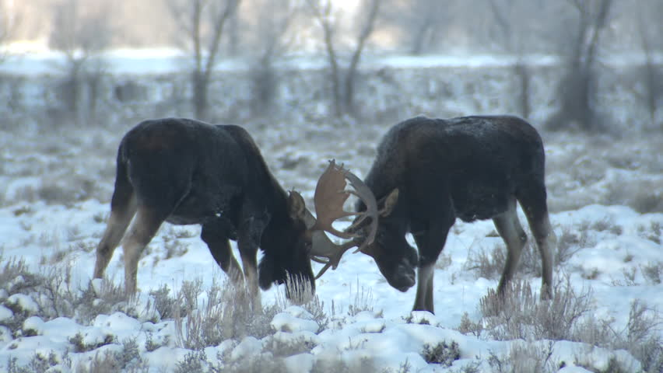
How the Board of Officers must handle these Issues
General Law Section
Incident Reports
What to do first
Paperwork
The Hearing
Decisions

Slide 3
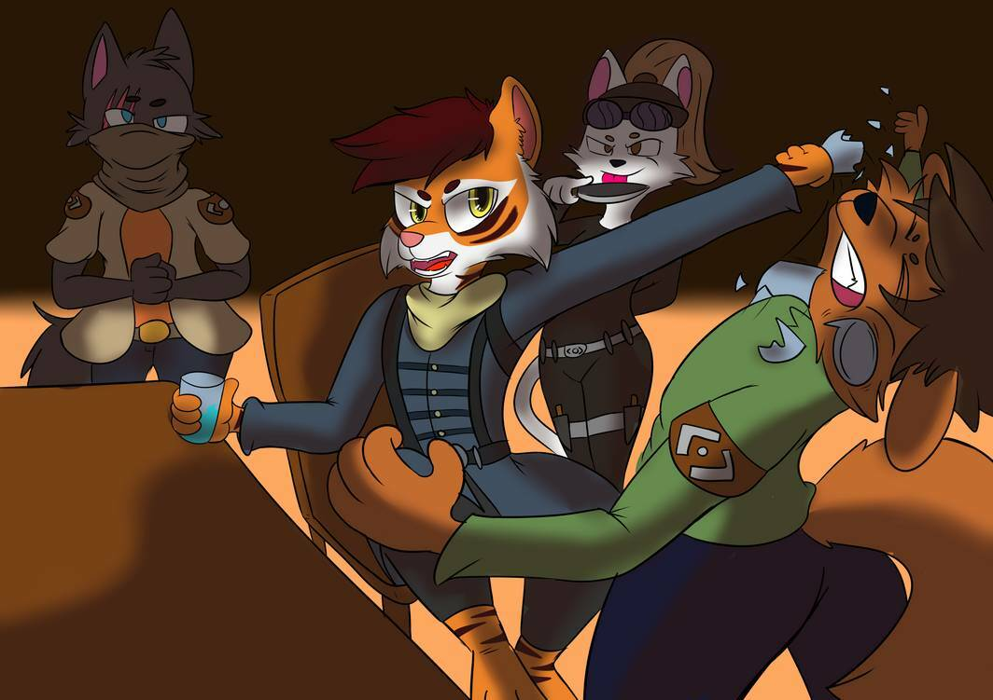
Decorum vs. Formal Charges
Decorum is handled by the Lodge.
Social Functions
Inappropriate behavior actions.
Formal Charges by Moose International.
Major infractions as a member.
Can include:
Behavior
Criminal Activity
Unbecoming actions.

Slide 4
Lodge Responsibility
GL 48.2 Provide and Enforce Rules
The use of a lodge social quarters:
Is a Privilege of Membership
Appropriate Conduct by members and guests is mandated.
The Lodge shall post House Rules.
All General Laws must be enforced.

Slide 5
Lodge Responsibility cont.
G.L. 48.8 - Enforce Decorum –
The Board of Officers shall be responsible for maintaining decorum in an equitable manner for all members and Qualified guests while in the Lodge Home.

Slide 6
What’s a Violation?
Any action violating a House Rule or General Law (examples):
Use of profane/vulgar language.
Improper dress.
Fighting.
Indecent conduct.
Aggressive actions / Sexual Harassment
Being destructive
Use of tobacco or tobacco products or cannabis or cannabis products.
Other misconduct or violations.

Slide 7
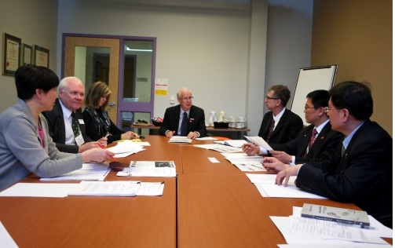
How are violations reported?
Lodge Staff.
Generally the Bar Tender or Mgr. on duty.
Members.
Generally the offended member.
Officers.
Generally in the S/Q or at a lodge event.
Lodge Board discusses reported violations in Executive Session to determine charges.

Slide 8
The Violation Process
Entry is made in Incident Log book.
Administrator brings violation to Board of Officers.
Board instructs Administrator to schedule hearing.
Hearing is conducted.
Discipline action (if any) is served upon member.

Slide 9
Administrator sends hearing notice to member.
Timelines must be maintained:
Notice must be delivered at least 5 days in advance of hearing.
It is suggested the Notice be mailed 10 days in advance of hearing date.
A copy of the Notice may be sealed in an envelope and left in Social Quarters behind bar for “in person” delivery by staff or officer of Lodge to addressed member.

Slide 10
The written Notice contains:
1. Date, Time and Location of hearing.
2. A detailed statement of the alleged wrongful conduct:
Date – Time – Location
Circumstances /Description of alleged conduct.
3. Rule or regulation violated.
4. Right of the member to testify at the hearing.
5. Right of the member to bring witnesses to the hearing.
6. Information advising the member he/she is not entitled to be represented or to confront and cross-examine witnesses.

Slide 11
SAMPLE LETTER TO APPEAR

Slide 12
Insufficient notices sent to members are the most frequent mistake. (Main cause for appeal)
Omitting sufficient details of the alleged wrongful conduct - could result in dismissing of charges!!
All details of the incident must be included in the notice.

Slide 13
Important
Don’t include witness(s) names in the Notice.
Don’t share the Incident Report.
Accused cannot be represented.
Accused may present witnesses.
Remember these . . .

Slide 14
Incorrect Notice examples:
Your actions on 0/00/00 were disorderly and ungentlemanly/unladylike.
Decorum charges have been filed against you for your conduct on 00/00/00.
The Board of Officers has received a complaint against you made by Mr./Ms. Smith.
The above examples do NOT have sufficient information to identify the where-when and what.

Slide 15
Correct Example
You are charged with an alleged violation of Section 48.8 of the General Laws for threatening member Bob Jones with bodily injury; said allegation including use of a beer bottle and physical action of taking a swing at him on December 31, 2021at approximately 10:30 PM in the Social Quarters of Mooseheart Lodge No. 2655.

Slide 16
Sample Letter to Appear
A Template of this notice (letter) can be found online at the Moose International website in the member area:
Forms and Documents
Compliance Office
Special Notices
Generic Notice to Appear before the Board

Slide 17
What if member refuses?
Won’t appear for hearing:
Suspension of privileges remains in effect.
The suspension is NOT lifted until a hearing is conducted.

Slide 18
Suspension of Privileges
A suspension of member privileges:
Applies to the charging lodge.
Includes ALL social functions – not just the Social Quarters.
Sporting events are social functions.
Member may still attend General Membership Meetings – may arrive 5 minutes before and must leave within 5 minutes after meeting ends. Cannot visit Social Quarters.
Applies to lodge property(s) not just lodge building.

Slide 19
The Hearing
Lodge President presides.
Administrator serves as recording Secretary.
The Notice is read and the attendees are recorded in record.
President must maintain order.

Slide 20
Hearing Rules
Charged Member is NOT entitled to representation.
Officers with vested interest in Charged Member, Member bringing charges, or any Witness should recuse themselves.
Witnesses shall be separated and not present in the hearing room at same time.
All questions will be asked by the Board.
Accused and Witnesses may not engage in discussions.
President shall preside and control hearing.

Slide 21
Hearing Process
After hearing is convened and charging letter and attendance have been read into record:
Call witnesses in order – President reminds them to tell the truth and answer questions; if they do not understand question they may ask for clarification.
Witnesses are in the room one at a time – after testimony they are dismissed and reminded NOT to talk about the hearing or case.
President should ask first question(s) and then call upon the officers in order to ask their question(s) – he/she can then ask one final time to each officer.

Slide 22
Hearing Process (cont.)
After Witness testimony – Questions are directed to Charged Member.
Use same order of questioning by Officers.
At the conclusion of questioning – ask the charged member if he/she wishes to make a closing statement.
President informs the charged member the hearing board will review the testimony (and any evidence) presented and will issue their decision which shall be noticed to charged member at that time.
President closes the hearing by noting the time and date for the record.

Slide 23
Post hearing rules
Do NOT discuss it!
Do NOT share information!

Slide 24
Status of Charged Member
Post Hearing:
If currently suspended remains in this status pending notice of hearing decision.
Is not permitted to visit S/Q if in suspended status. Must depart property within 5 minutes of the close of hearing.

Slide 25
Questions before the Hearing?
Procedural questions can be answered by TM, RM or Compliance Office
630-966-2207 or via email: micompliance@mooseintl.org

Slide 26
Deciding Guilt / Consequences
Executive Session – hearing officers.
Examine and Discuss the testimony and evidence.
Vote to determine guilt or innocence.
If guilty – determine the penalty.
Notify the Charged.
The scales of justice!

Slide 27
Determining the Penalty
Penalty fits the charge.
There is NO action known as Probation.
Penalties are delivered in days of lost privilege.
Be consistent.
Credit for days suspended.
Progressive penalties are acceptable.
The Rule of Fair & Impartial

Slide 28
Finally!!!
Notify the member of the
Board’s decision by mail in a reasonable amount of time, preferably within 48 hours of the hearing. *No probation*
Do not give them your decision after your meeting so they don’t disrupt your Members in the Social Quarters.

Slide 29
Here is an example of a determination letter.
There is no template online, but you can contact the Compliance Office and we can provide one. The letter just needs to provide the board’s decision on any suspension

Slide 30
Can a member appeal?
Yes
To the Office of Compliance.
Decision turnover is generally for procedural error.
Maintain a good record of the process to reply for appeals.

Slide 31
LODGE INCIDENT REPORT BOOK
All lodges operating a Social Quarters MUST have, and Use a SQ Incident Log Book.
Questions about Log Book?
Contact your Territory Manager or the Office of Compliance.
Need a new one? Lodges email OOC: micompliance@mooseintl.org

Slide 32
Lodges are required . .
To operate:
Safely
Friendly
Family welcoming
Enjoyable
House Rules & General Laws protect.
Decorum Enforcement preserves.

Slide 33
If You have any Questions Please Do Not Hesitate to Call your Territory Mgr. Or the Compliance Office
Phone 1-630-966-2207
micompliance@mooseintl.org
Fax 1-630-966-2208

Slide 34
Thank You, Thank You, Thank You
For all You do
for Our Children at Mooseheart
and
Our Seniors at Moosehaven

Slide 35
Thanks also for your attendance!
Wish to make a comment about this Workshop or suggest a topic for a future Workshop?
Email:
Mike Rios, Director of Membership
mrios@mooseintl.org
Thanks again!

