Slide 1
Welcome to the How To Increase The Business
In Our Lodge Homes Workshop.

Slide 2
A Guide to the Who, What, When, Where, and How.
We will be discussing ideas that can help to increase business in your lodge homes and help increase your revenue…

Slide 3
Who is Responsible????
The Board of Officers
Committee Chairperson
Bartenders
The Membership

Slide 4
Who is Responsible????
The Board of Officers

Slide 5
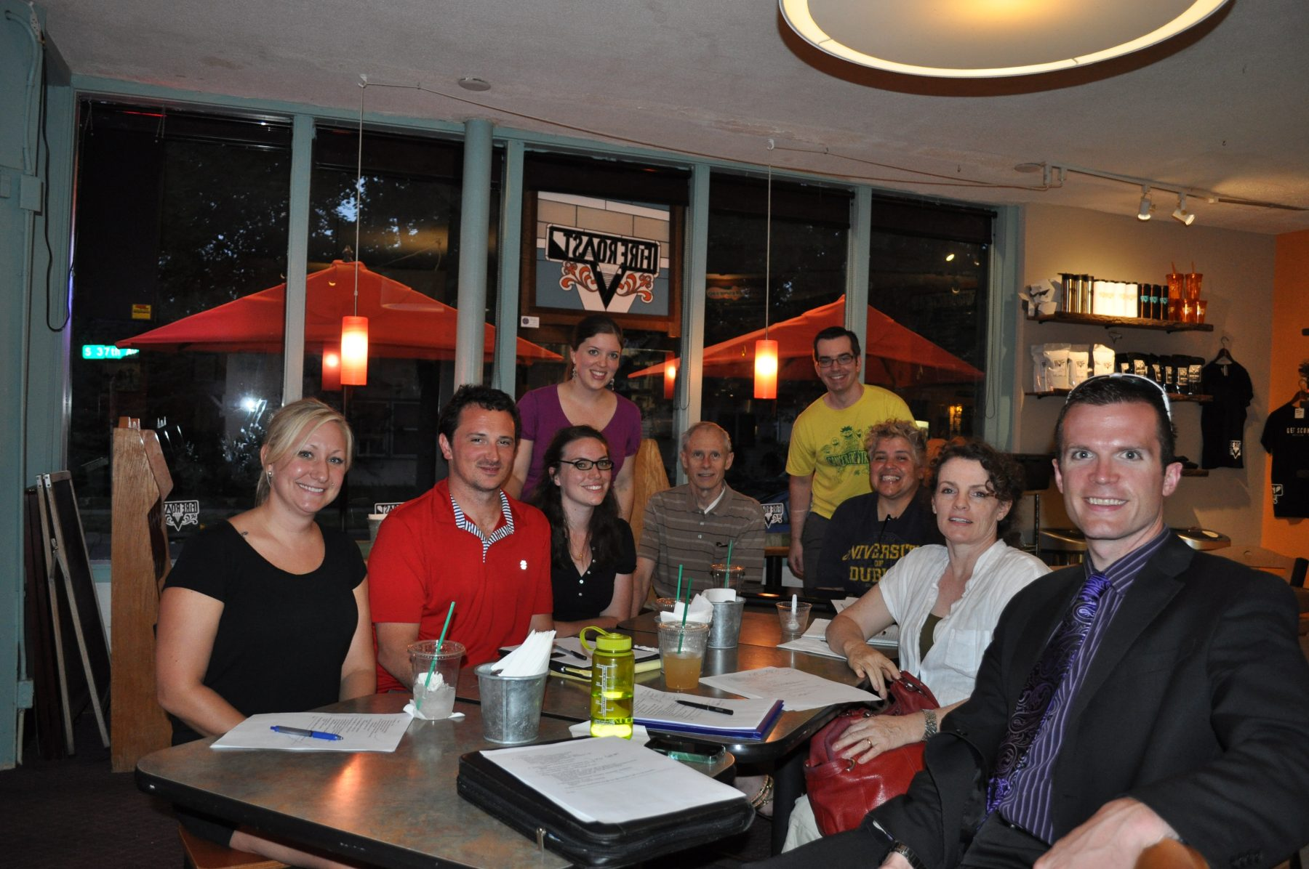
Who is Responsible????
Committee Chairperson

Slide 6
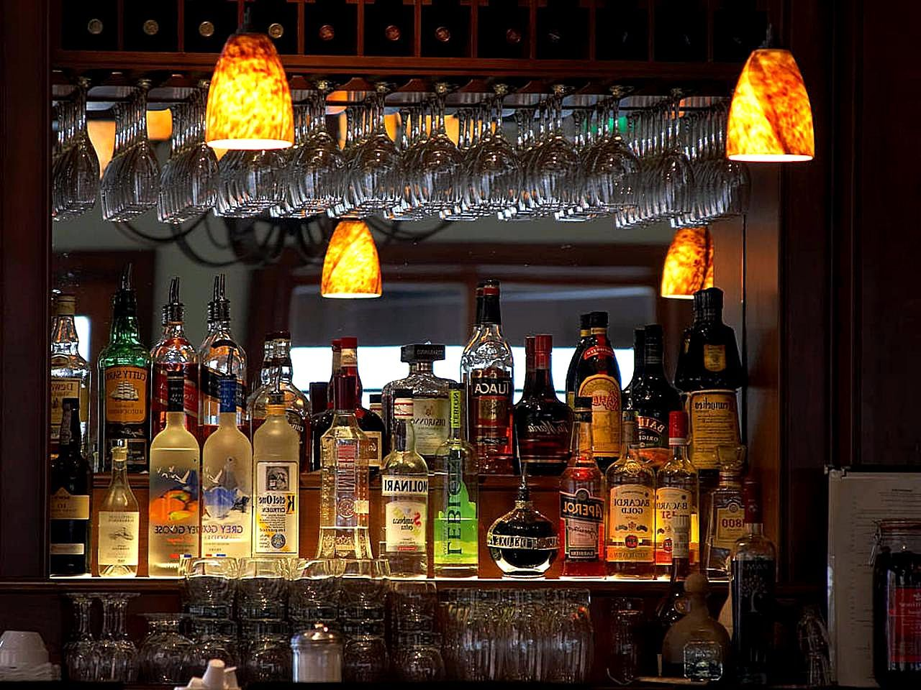
Who is Responsible????
Bartenders

Slide 7
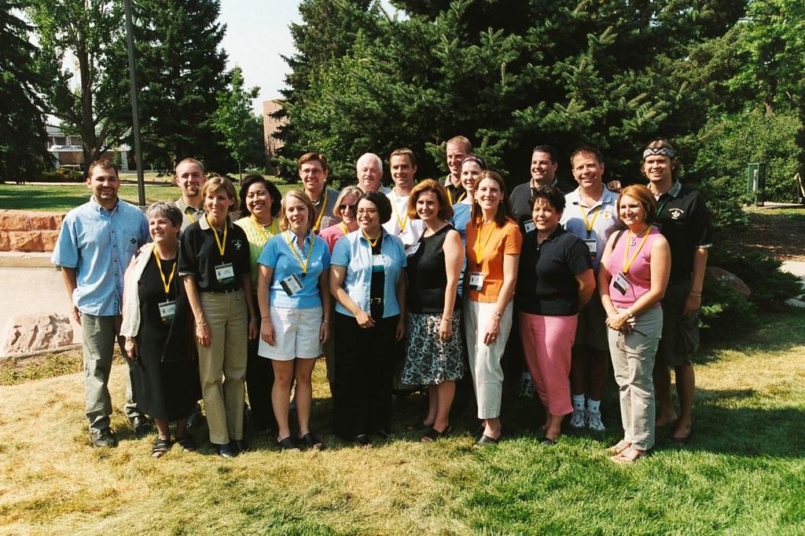
Who is Responsible????
The Membership

Slide 8
Answer: Everyone!!!!

Slide 9
What can the Board of Officers Do?
Create Membership Incentives
Have a Retention plan to retain first year members.
Conduct regular orientations.
Lead by example…
Ask for help/volunteers…
Thank the Volunteers…

Slide 10
Create Membership Incentives
These Posters can be found on MI Website under Member Information/Campaigns.
Have Monthly Membership Drawings for those that Sponsor new members. For every new or re-enroll they get a ticket into the drawing.
Give the Monthly winner a Prize.
Free dinner
Moose Bucks
Gift Cards
Top Sponsor of the Month Recognition in Newsletter or Certificate.

Slide 11
Have a Retention Plan to retain first year Members
Designate Anniversary Dates Monthly, Bi-Monthly Quarterly to recognize those members.
Have an Annual Pin Ceremony. Lodge Length of Membership Pin 5 thru 60 Year member in increments of 5 years available from Catalog Sales.
Membership/Retention Committee should make phone calls to these members.
Have a Party or Dinner to recognize those members.

Slide 12
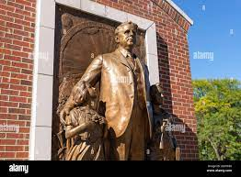
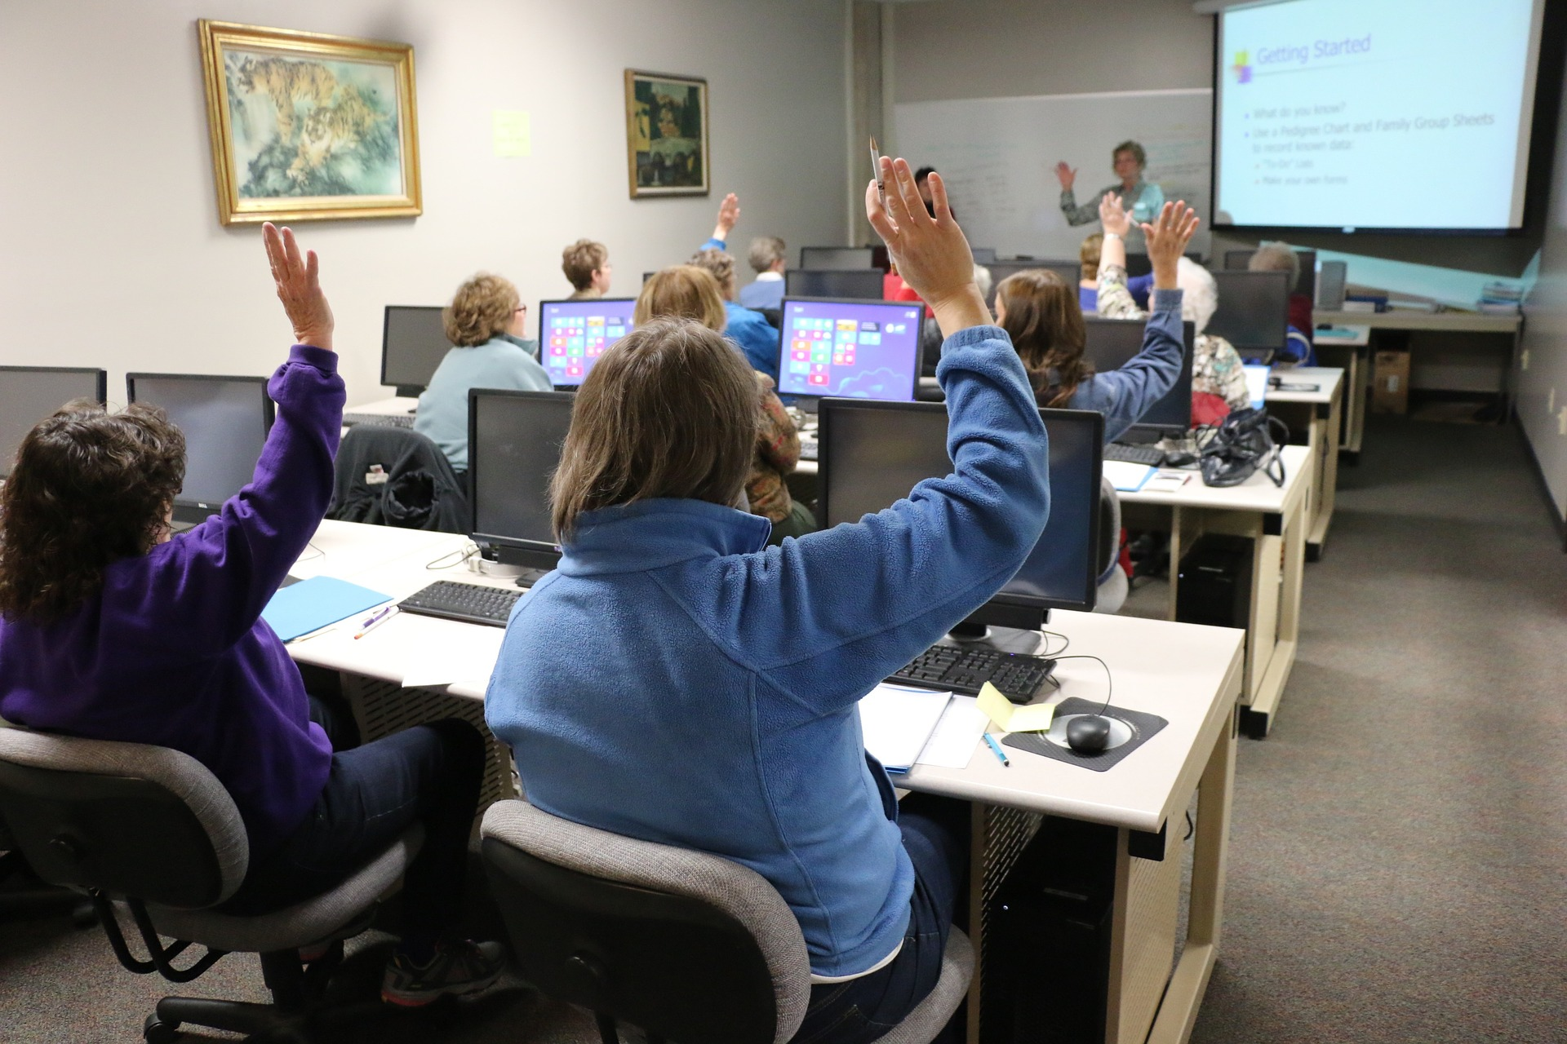
Conduct Regular Orientations. At least every other month…
Have regular orientation or enrollment ceremonies
Invite New Members and their Sponsors
Have a Free/Inexpensive Dinner or Raffle Prize in conjunction with the orientation
Be Knowledgeable and ready to answer Questions
Be sure to Give Sponsors the Annual Campaign Pin
HAVE FUN AS WELL…

Slide 13
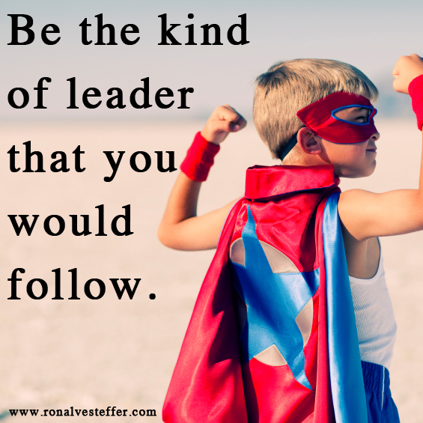
Lead By Example…
Smile and Greet Members when they enter the lodge
Ask the volunteers doing a function if they need any help
Take out the trash when you see it needs to be done
Clean up something if you see it needs it
Talk to members with Respect (Don’t talk Down to them)
DON’T TALK LODGE BUSINESS OUSIDE OF THE MEETING ROOM, ESPECIALLY IN THE SOCIAL QUARTERS…

Slide 14
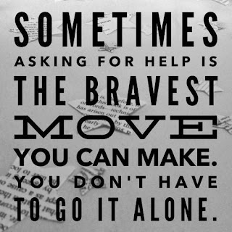
Ask for help/volunteers…
Ask members if they can volunteer or help out with something. (Most members say they weren’t asked)
Start with something small (taking out the trash, getting ice, etc.)
Have a volunteer sign up sheet for events and/or functions.

Slide 15
RECOGNIZE AND
THANK THE VOLUNTEERS!!.

Slide 16
What can a Committee Chairman Do?
Reach out to Members for Help
Properly Plan the Function
Have regular meetings with the other committee members
Advertise the function in advance
Make it Fun!!!!

Slide 17
Reach out to Members’ for Help
You would be surprised how many people will step up to help if they are asked
Find the members strengths
Cooking, planning or decorating
Work together as a TEAM!!!

Slide 18
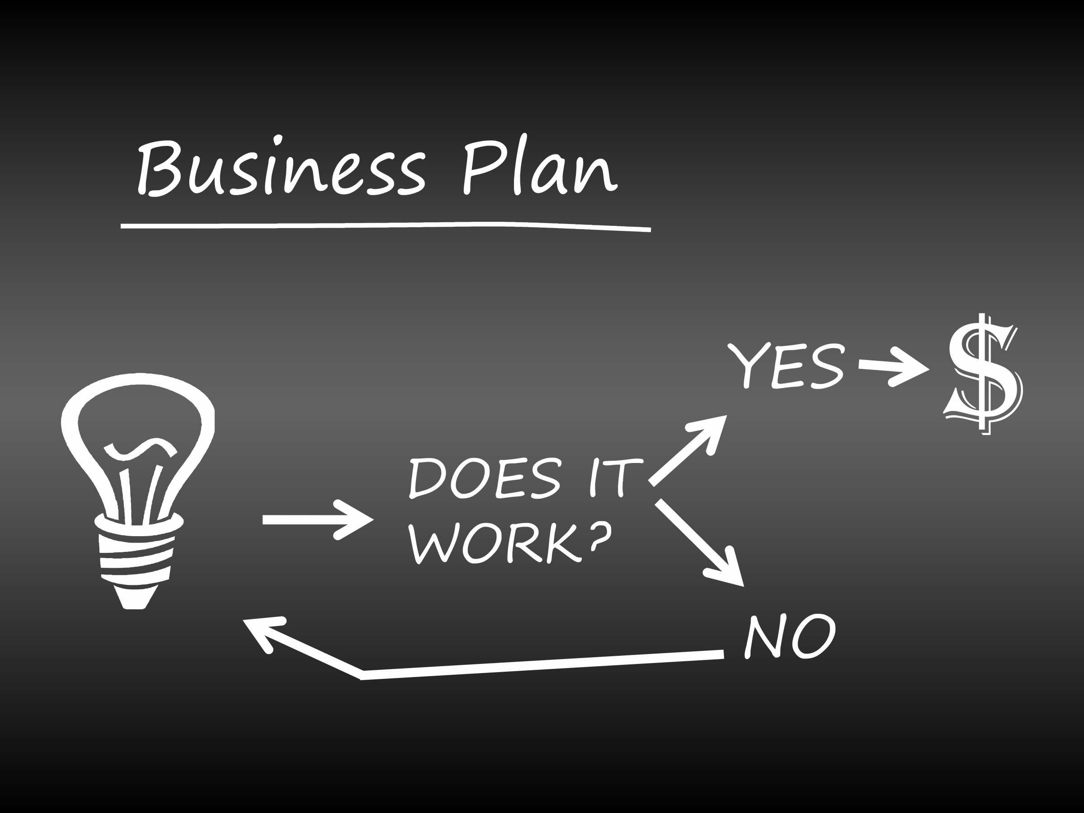
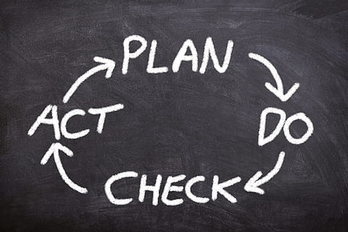
7 Steps For Planning a Successful event
What are the 7 steps in planning a successful event?
7 Steps to event planning success
Define your objectives. Always ask yourself beforehand, “What are you hoping to achieve from this event?” ...
Choose your location. Make sure that your location aligns with your objectives. ...
Set a date. ... Plan in Advance
Create a plan. ...Get a Team together
Issuing invitations. ...Send in Newsletters or Social Media
The day of the event. ...Have a Crew set to Make it Happen
Evaluate. Was it successful and did Members Enjoy???

Slide 19
How can Your Bartenders Help Increase Revenue???
Check Membership Cards Daily!

Slide 20
How can Your Bartenders Help Increase Revenue???
Smile:
Be Welcoming and Courteous!

Slide 21
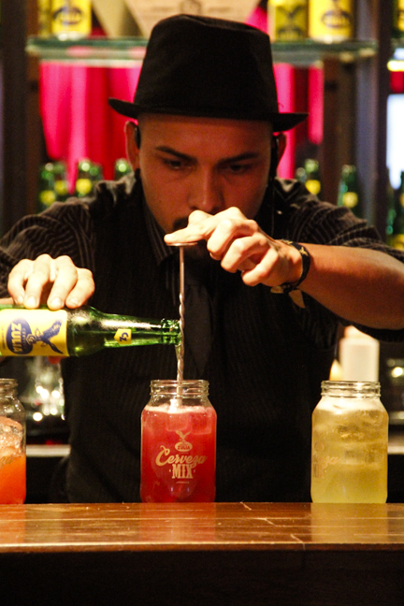
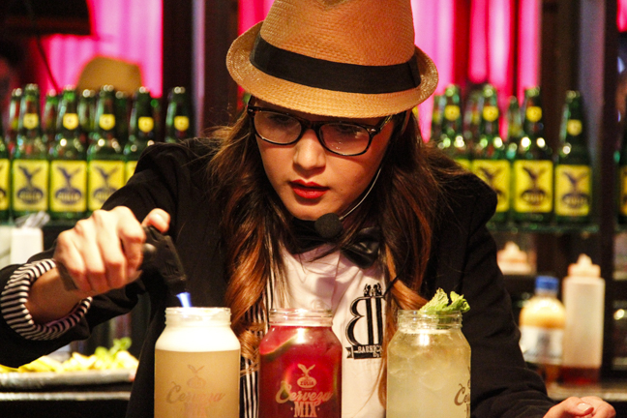
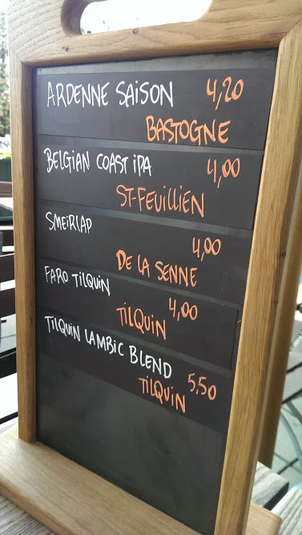
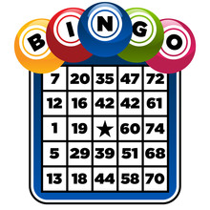
How can Your Bartenders Help Increase Revenue???
Work with SQ Manager and BOO about Drink Specials/Happy Hour, etc.
Have Games Incentives to Play for Prizes
Number of the Day
Bar Bingo
Trivia Night

Slide 22
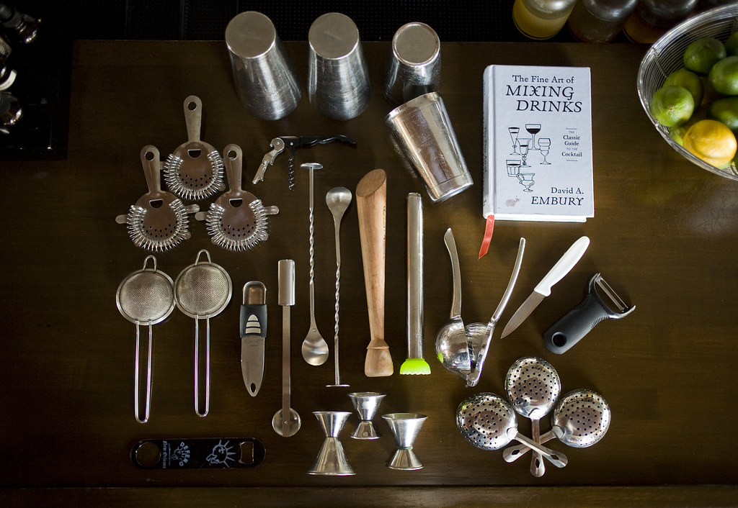
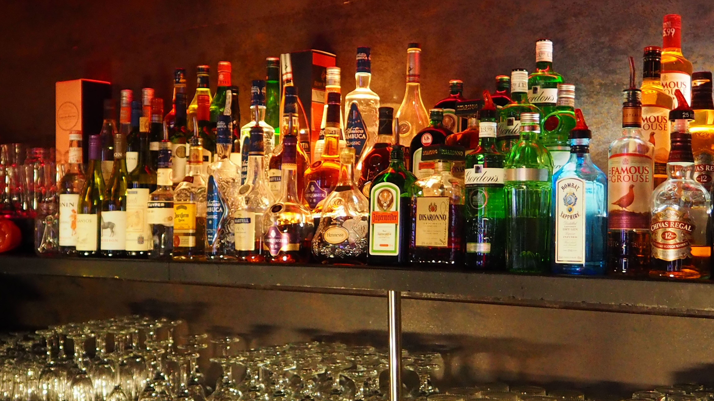
How can Your Bartenders Help Increase Revenue???
Use Proper tools for making drinks
Standardized Drink Pour
Know How to Make Popular drinks
Make sure that SQ Mgr. and BOO know when inventory is needed
Be TiPS Certified or similar State Certification.

Slide 23
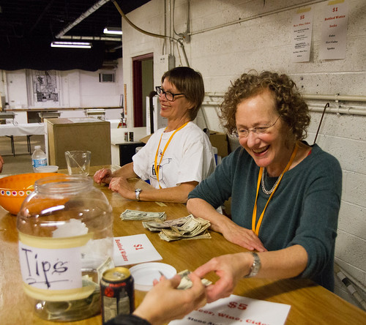
How can Your Bartenders Help Increase Revenue???
Ask Members How they are Doing?
However…
Don’t Engage in Gossip or Lodge Business!!!

Slide 24
How Can The Membership Help to Increase Lodge Revenue and Business
Volunteer to Help with a function or Event
Ask an officer of the Lodge or Chapter, How you can help
Create an Event that you would like to see
Get More Involved for the Betterment of the Lodge as a Whole…
This Photo by Unknown Author is licensed under CC BY-SA

Slide 25
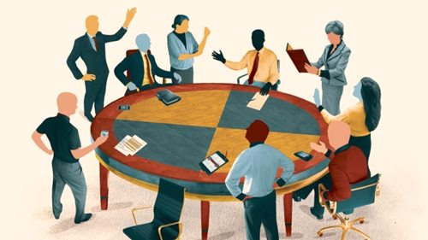
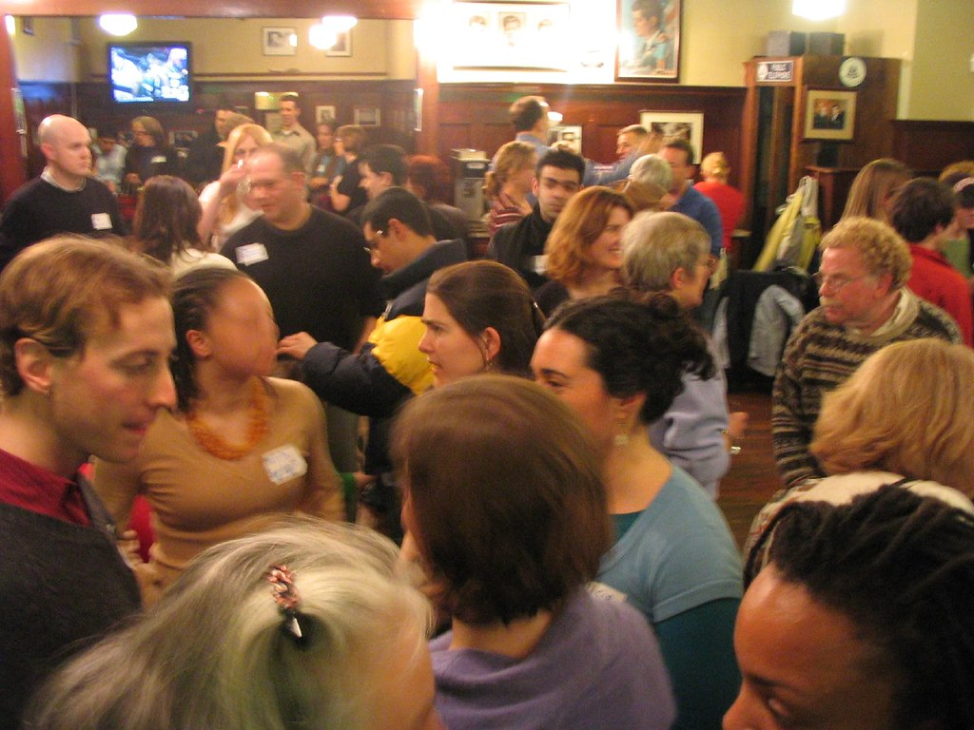
How Can The Membership Help to Increase Lodge Revenue and Business
Attend Meetings
Attend events and Functions
Most Importantly if your not helping
Don’t Criticize those who have VOLUNTEERED!!!
Before You Criticize
Someone Else For
Their Mistakes
Make Sure That You’re
Not One of Them…

Slide 26
If You have any Questions? Please Do Not Hesitate to Call your Territory Mgr. Or the Compliance Office
Phone 1-630-966-2207
micompliance@mooseunits.org

Slide 27
Thank You, Thank You, Thank You
For all you do for Our Children at Mooseheart
And
Our Seniors at Moosehaven as well as your local communities.

Slide 28
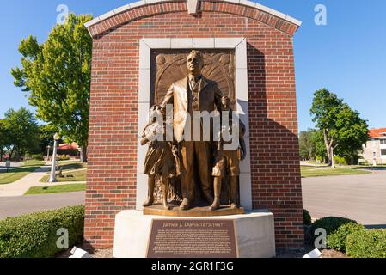
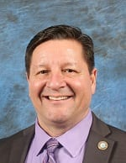
Thank you for your attendance
Wish to make a comment about this Workshop or suggest a topic for a future Workshop?
Email:
Mike Rios, Director of Membership
mrios@mooseintl.org
Thanks again!

